Slide 1
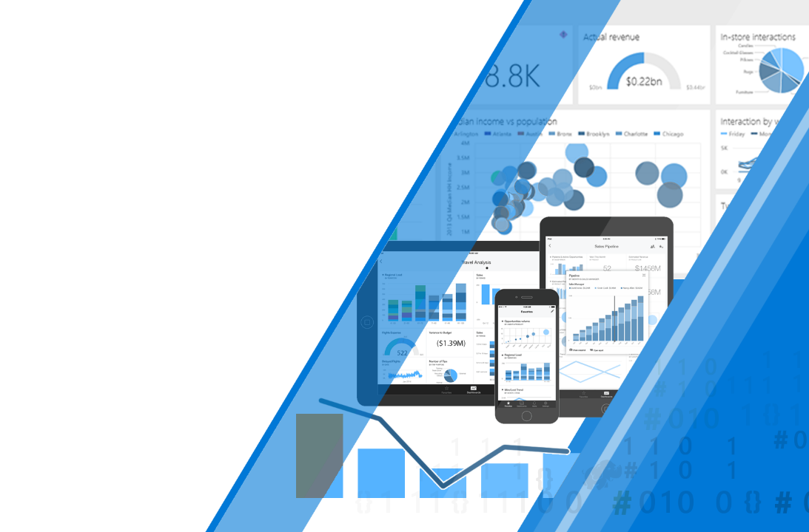
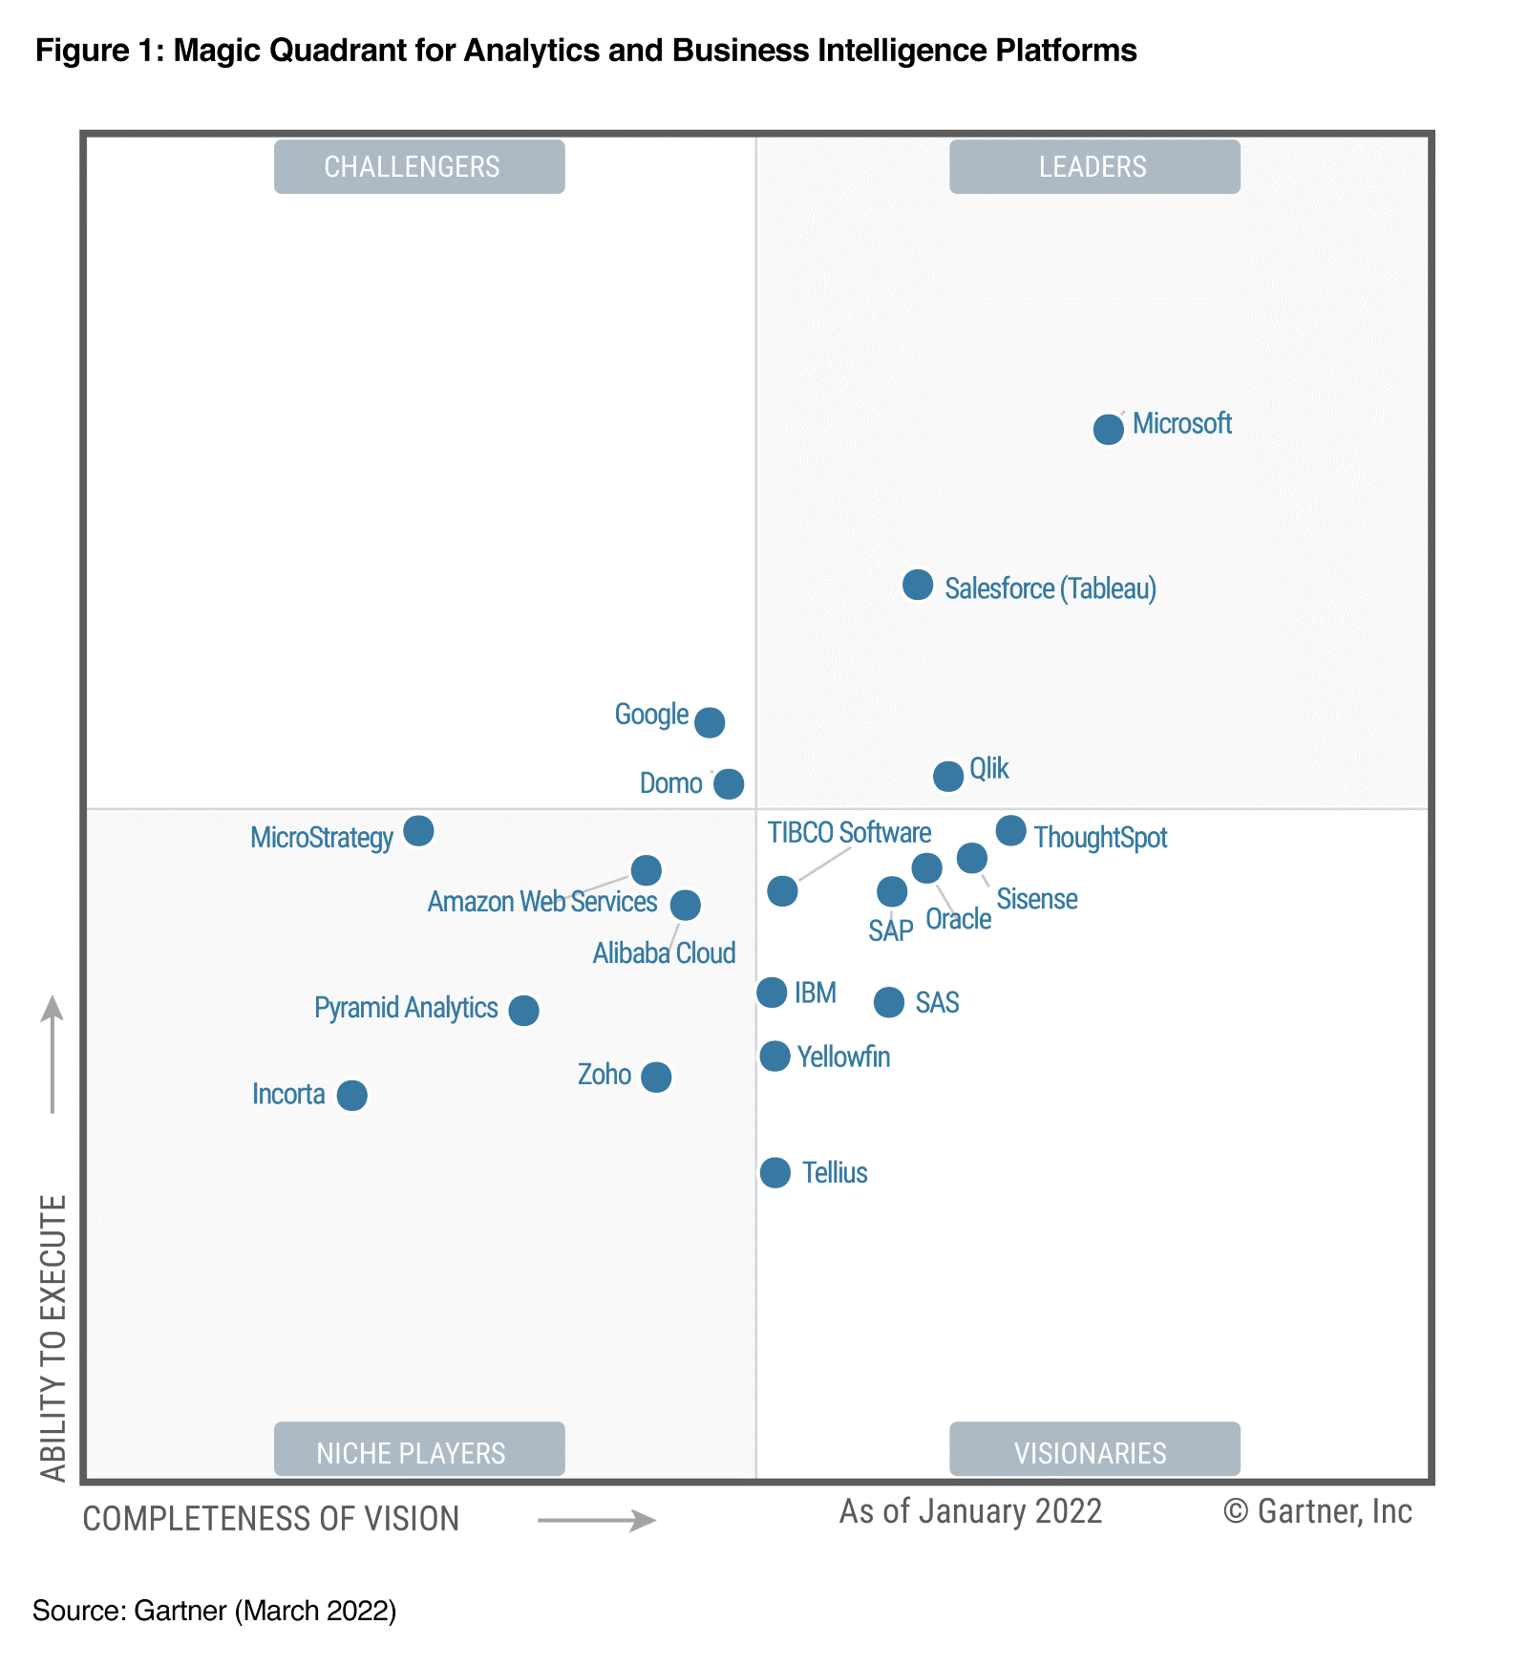
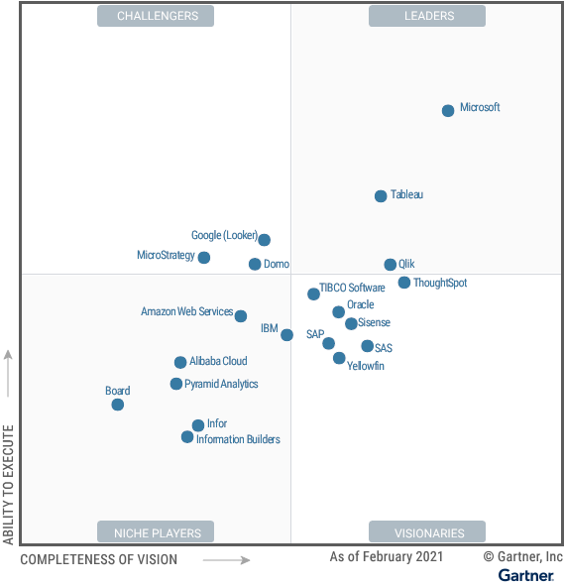
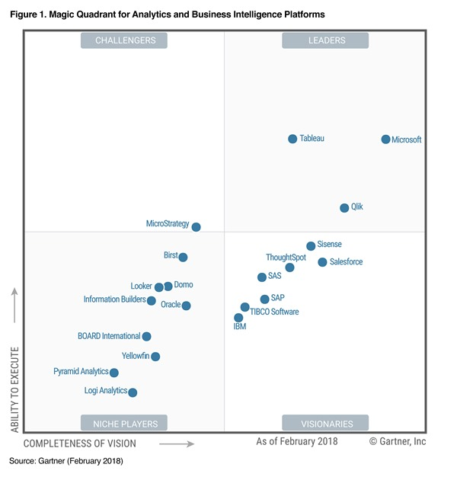
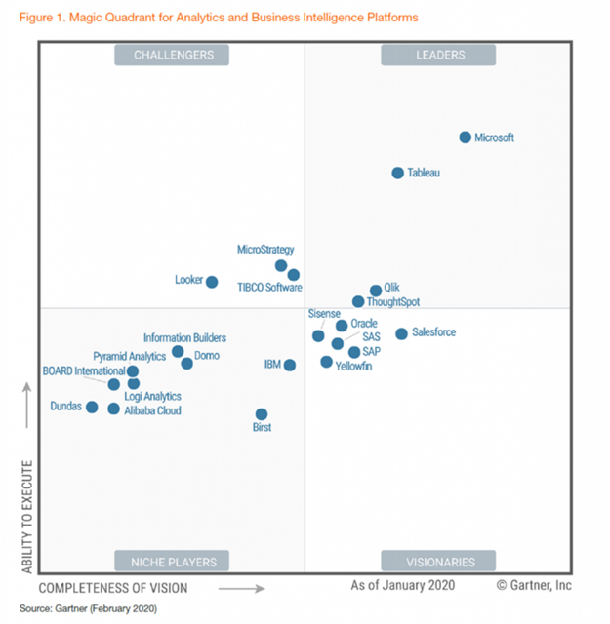
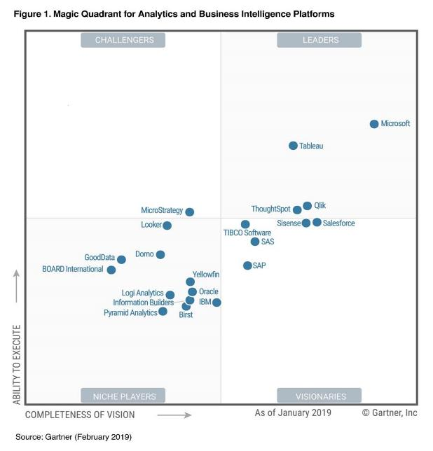
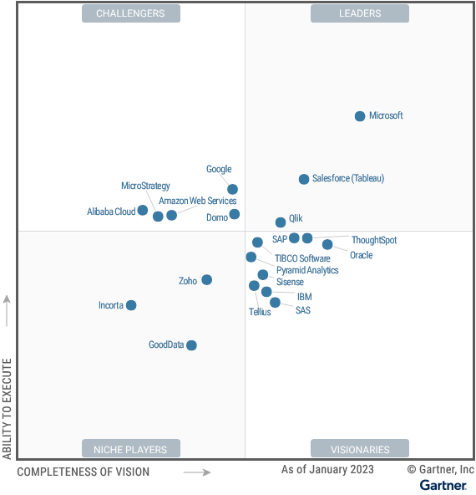
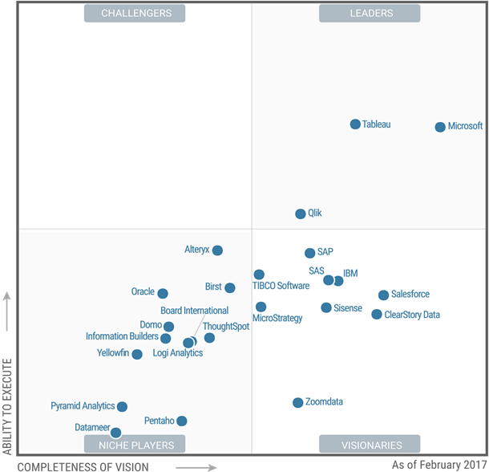
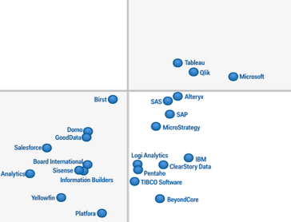
Microsoft Power BI
Enterprise Deployment Workshop
github.com/tylerchessman/PBIEnterpriseDeploymentWorkshop
Gartner Magic Quadrant for Business Intelligence & Analytics Platforms, February 2016
Tyler Chessman (tylerc@Microsoft.com)
Last Saved: Feb 2023
* Gartner Reprint
Notes:
**This graphic was published by Gartner, Inc. as part of a larger research document and should be evaluated in the context of the entire document. The Gartner document is available upon request from Microsoft. Gartner does not endorse any vendor, product or service depicted in its research publications, and does not advise technology users to select only those vendors with the highest ratings or other designation. Gartner research publications consist of the opinions of Gartner’s research organization and should not be construed as statements of fact. Gartner disclaims all warranties, expressed or implied, with respect to this research, including any warranties of merchantability or fitness for a particular purpose.
- https://powerbi.microsoft.com/en-us/blog/gartner-recognizes-microsoft-as-a-leader-in-analytics-and-bi-platforms-for-11-consecutive-years/

Slide 3
Agenda
Introductions and Expectations for the Day
Architectural Overview of Power BI
Roles/Responsibilities
Provisioning of Services, Users, & Software
Training and Evangelism
Managing/Exposing Data Sources
Publishing and Sharing Content - Best Practices
Supporting Data Refresh and Live Connections
Security Best Practices
Monitoring and Auditing activity

Slide 4
Agenda (May 13th, 2022)
Architectural Overview of Power BI
Tabular Models in a mixed environment
Enterprise Models in Power BI
Design pattern for "on-demand" report generation (i.e. Qlik capability)
Paginated Reports | Migration of Paginated Reports (e.g., Crystal)
Publishing & Sharing Options/Best Practices
Misc
Using Power Automate to augment Subscription capabilities
Using Calculation Groups to manage Time-Intelligence Sprawl
CDM Integration
Notes:
-Architectural Overview of Power BI
-Tabular Models in a mixed environment
-Migrating Enterprise Models (e.g., Universe) to Power BI
-Design pattern for "on-demand" report generation (i.e. Qlik capability)
-Migration of Paginated Reports (e.g., Crystal)
-Misc
-Using Power Automate to augment Subscription capabilities
-Using Calculation Groups to manage Time-Intelligence Sprawl
https://www.sqlbi.com/calculation-groups/

Slide 5
Notes
This material was originally developed in 2017
It is intended to be delivered as a 1-day workshop (instructor led – with demos, no formal hands-on activities)
I periodically maintain/refresh this material – please check the GitHub repository for updates, https://github.com/tylerchessman/PBIEnterpriseDeploymentWorkshop
Additional resources are also available, including
Planning a Power BI Enterprise Deployment - Power BI enterprise deployment whitepaper - Power BI | Microsoft Docs
Power BI Premium Planning and Deployment - Deploying and Managing Power BI Premium Capacities - Power BI | Microsoft Docs
Power BI Adoption Framework/guidance
Power BI Adoption Framework that includes a series of PowerPoint decks and videos, https://github.com/pbiaf
Update (June 2021) – Power BI adoption roadmap, Power BI adoption roadmap - Power BI | Microsoft Docs
Please refer to the Power BI Whitepapers web-page for additional resources: https://docs.microsoft.com/en-us/power-bi/guidance/whitepapers
Notes:
Best practice rules to improve your model&#8217;s performance | Microsoft Power BI Blog | Microsoft Power BI
Document a Power BI file and report in a few clicks: all DAX code, visualization, Power Query scripts - RADACAD

Slide 6
Azure Data Services Overview
GATHER
STORE
MODEL
ANALYZE
SHARE
ETL
RDW
Reporting
Portal
SSIS
OLAP
SSRS
SharePoint
SQL Svr
Power BI Report Builder
Power BI Service / Premium
Data Factory
Synapse Pipelines
Synapse Analytics
Traditional Apps (structured)
SSAS
Data Lake
Analysis Services / PBI Premium
Schema on Write
Custom Apps
Data Lake Gen2 Storage
Ad-hoc
Power BI Embedded
Excel
Media (unstructured)
Power BI Desktop
Schema on Read
Hadoop
Cold Path
Synapse Analytics
Databricks
HD Insight
Files (unstructured)
Event Ingress
CEP
IoT Edge
Event Hub
IoT Hub
Stream Analytics
Cosmos DB
ADX / TSI
Hot Path
ML/AI
Logs (unstructured)
Power BI,
Azure Functions
Etc.
ML Services, Cognitive Services
Inventory Assess & Govern Discover & Enrich
Azure Purview
Notes:
Power BI as a superset of Azure Analysis Services | Microsoft Power BI Blog | Microsoft Power BI

Slide 7
Microsoft Fabric Overview
GATHER
STORE
MODEL
ANALYZE
SHARE
ETL
RDW
Reporting
Portal
SSIS
OLAP
SSRS
SharePoint
SQL Svr
Report Builder
Power BI / Fabric Capacity
Pipelines
SQL
Endpoint
Traditional Apps (structured)
SSAS
Data Lake
Datasets
Schema on Write
Custom Apps
One Lake
Fabric Capacity / Embedded APIs
DataFlows G2
Spark Notebooks
Ad-hoc
Excel
Media (unstructured)
Workspace
PBI Desktop
Transformation
Schema on Read
Hadoop
Cold Path
Spark
Files (unstructured)
Event Ingress
CEP
Edge Device
Event Hub
Custom App
Eventstream
KQL Database
Hot Path
ML/AI
Logs (unstructured)
Spark
Custom App
Inventory Assess & Govern Discover & Enrich
Fabric | Microsoft Purview

Slide 8
Azure Data Services Architecture
GATHER
STORE
MODEL
ANALYZE
SHARE
ELT
RDW
Reporting
Portal
Future Synapse Dedicated Pool
Enterprise Models
Synapse Pipelines
Future
Power BI Report Builder
Power BI Service / Premium
On-Premise Database(s)
(structured)
Extract, Load
Data Lake
PBI Premium
Data Lake Gen2 Storage
Future
Synapse DataFlows
Transform
Power BI datasets will be sourced from ADLS G2 Storage
Ad-hoc
Media | Files | Logs (semi-structured)
Power BI Desktop
Notes:
Power BI as a superset of Azure Analysis Services | Microsoft Power BI Blog | Microsoft Power BI

Slide 9
Azure Data Services Architecture
Source Systems
GATHER
STORE
MODEL
ANALYZE
SHARE
On-Premise Database(s)
(structured)
Media | Files | Logs (semi-structured)
Notes:
Power BI as a superset of Azure Analysis Services | Microsoft Power BI Blog | Microsoft Power BI

Slide 10

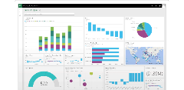


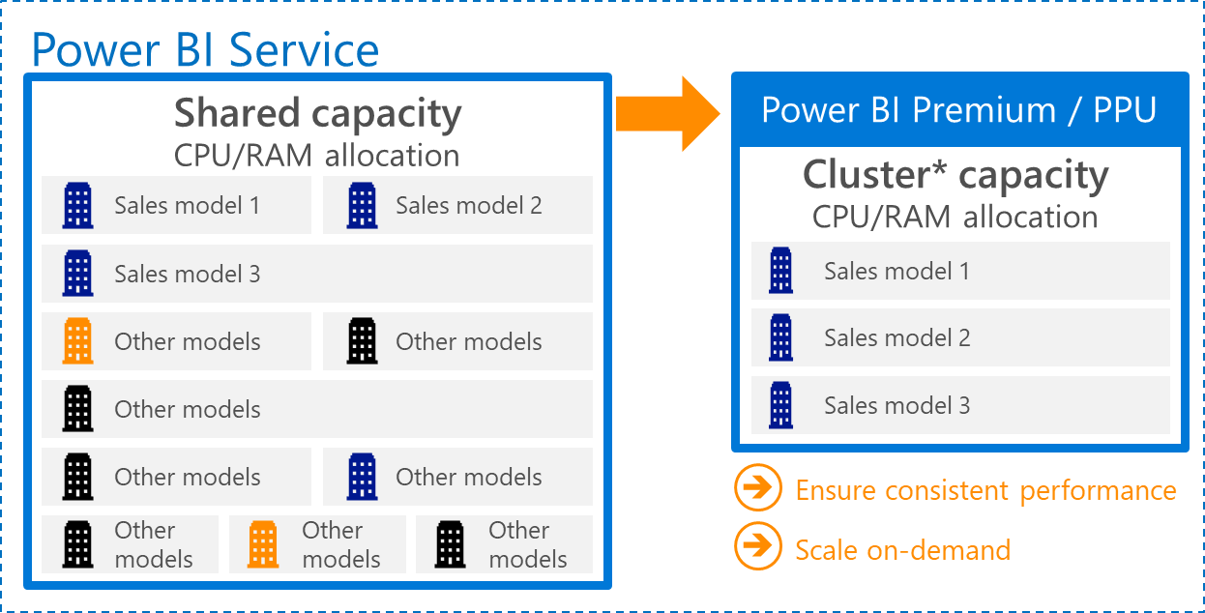
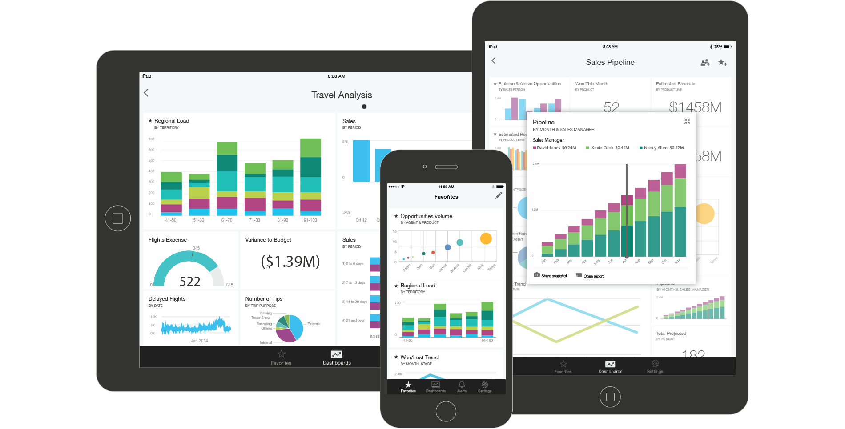





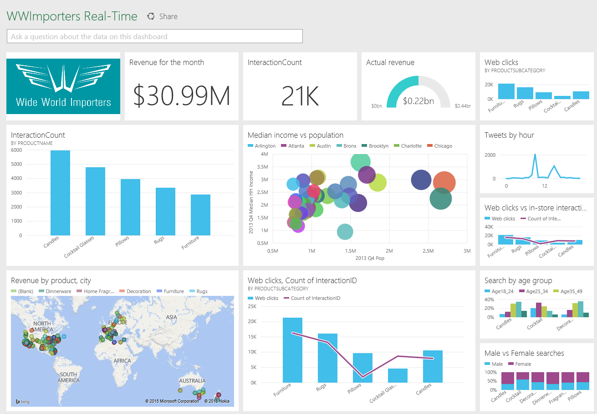
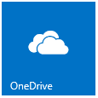


Power BI Technical Architecture
Bring your data…..
…to life
SaaS Data Sources
Power BI web browser
With natural language query, visual exploration etc.
Power BI Mobile Apps
with dashboards, alerting and visual exploration
Azure-resident systems
Azure SQL
Azure Stream Analytics
Excel
Data can be cached or directly queried in place
Publish
Databricks
Power BI Desktop
Embed Dashboards & Reports in custom applications
On-premise systems / other
Author
On Premise Data Gateway
SQL / APS
Data Refresh and/or DirectQuery/Live Connections
Corporate Data Sources
SSAS and Others

Slide 11
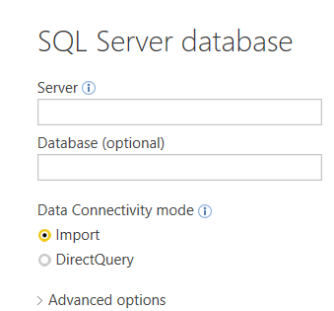
Power BI Authoring Datasets - cached (imported) versus live (direct query)
The building blocks of authoring content in Power BI are a -
Dataset (aka Data Model) – detailed data, metadata (e.g., table/column names), and relationships among data tables
Report (can be created in the PBI Desktop – and/or in the Power BI Service via a browser)
Dashboard (created in the Power BI Service)
Most Datasets are first built in the Power BI Desktop, with a few notable exceptions -
Apps e.g., Salesforce, Google Analytics, etc. are created directly in the Power BI Service
They are “imported” datasets (see below) – and may be refreshed on a schedule
Streaming Datasets are also created in the Power BI Service
an API is used to push (stream) data directly into these datasets; they are typically used for near “real-time” dashboards
Authors may choose to first use PBI dataflows to extract/transform/load data – and then load the dataflow into the Desktop
When creating a dataset, the author in most cases decides to either* -
Import data. Data is pulled down, compressed, and saved as part of the Power BI Desktop file (.pbix).
Data from 1-to-many disparate data sources can be mashed-up and related together; data is refreshed on-demand
Create a Live Connection (DirectQuery / Connect Live**) . A connection to 1 data source*.
Only “metadata” (e.g., table names, field names, relationships between tables) is pulled down and stored in the desktop file
Note - support for live connections is limited to a smaller set of data sources (e.g., SSAS, SQL Server, Oracle, SAP Hana, Teradata)
*Composite Models can include multiple DirectQuery and Import data connections - https://docs.microsoft.com/en-us/power-bi/desktop-composite-models
**Live Connect is reserved for Analysis Services database (and is the method used for connections to Power BI datasets)

Slide 12
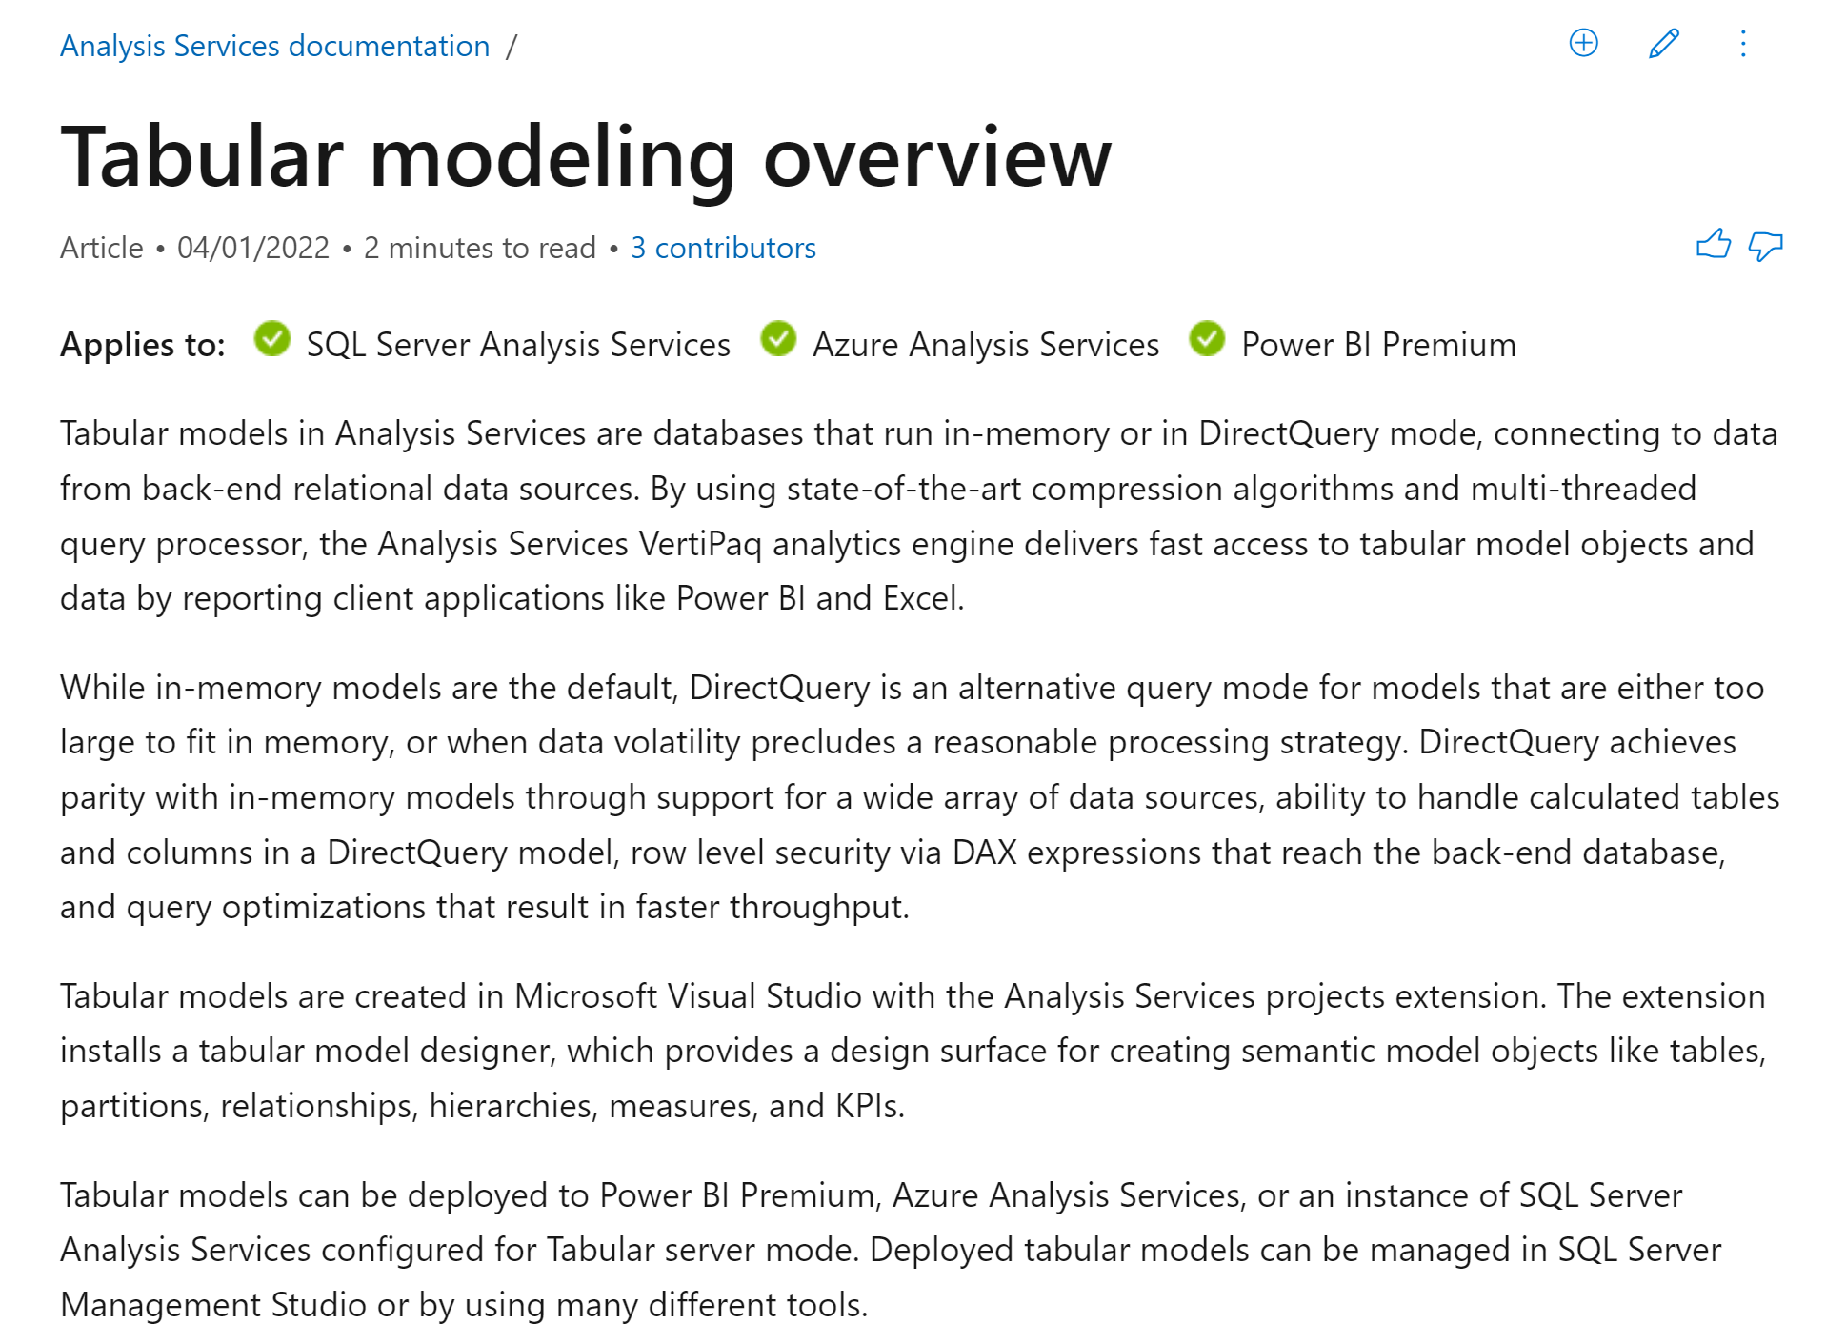
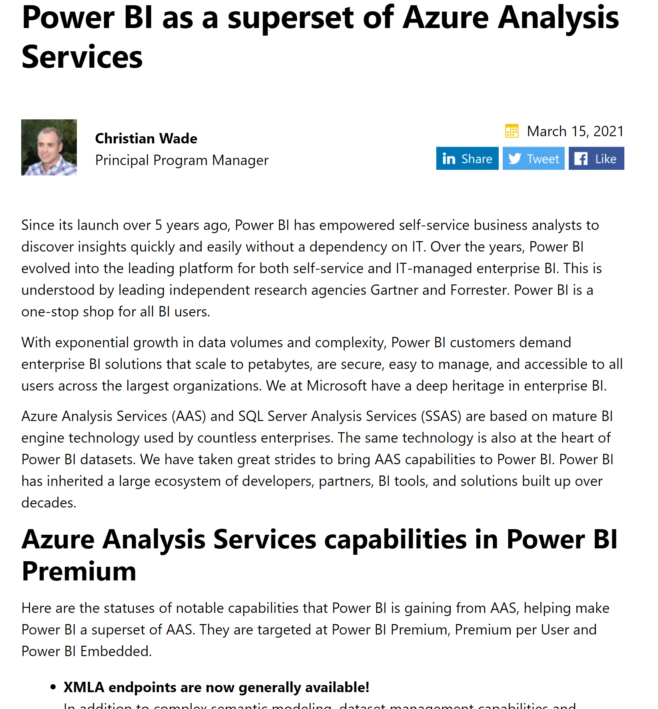
Power BI Authoring Datasets – architecture & reusability
A Power BI dataset is a Tabular Model
Based on SQL Server Analysis Services (tabular mode) - Tabular modeling overview - Analysis Services | Microsoft Docs
Power BI Premium is where most future investments are taking place – Power BI as a superset of Azure Analysis Services | Microsoft Power BI Blog | Microsoft Power BI
Any technology that can communicate via the XMLA protocol can connect to a Tabular Model for read/write activities.
Microsoft provides drivers to simplify this communication (e.g., Developing with ADOMD.NET | Microsoft Docs)
Note that XMLA is also supported by other multi-dimensional databases like SAP HANA and Essbase
Datasets hosted in Power BI Premium can be read/write by other technologies e.g.,
Excel*, Tableau, Report Builder
SSMS, Visual Studio, Tabular Editor
Back

Slide 13
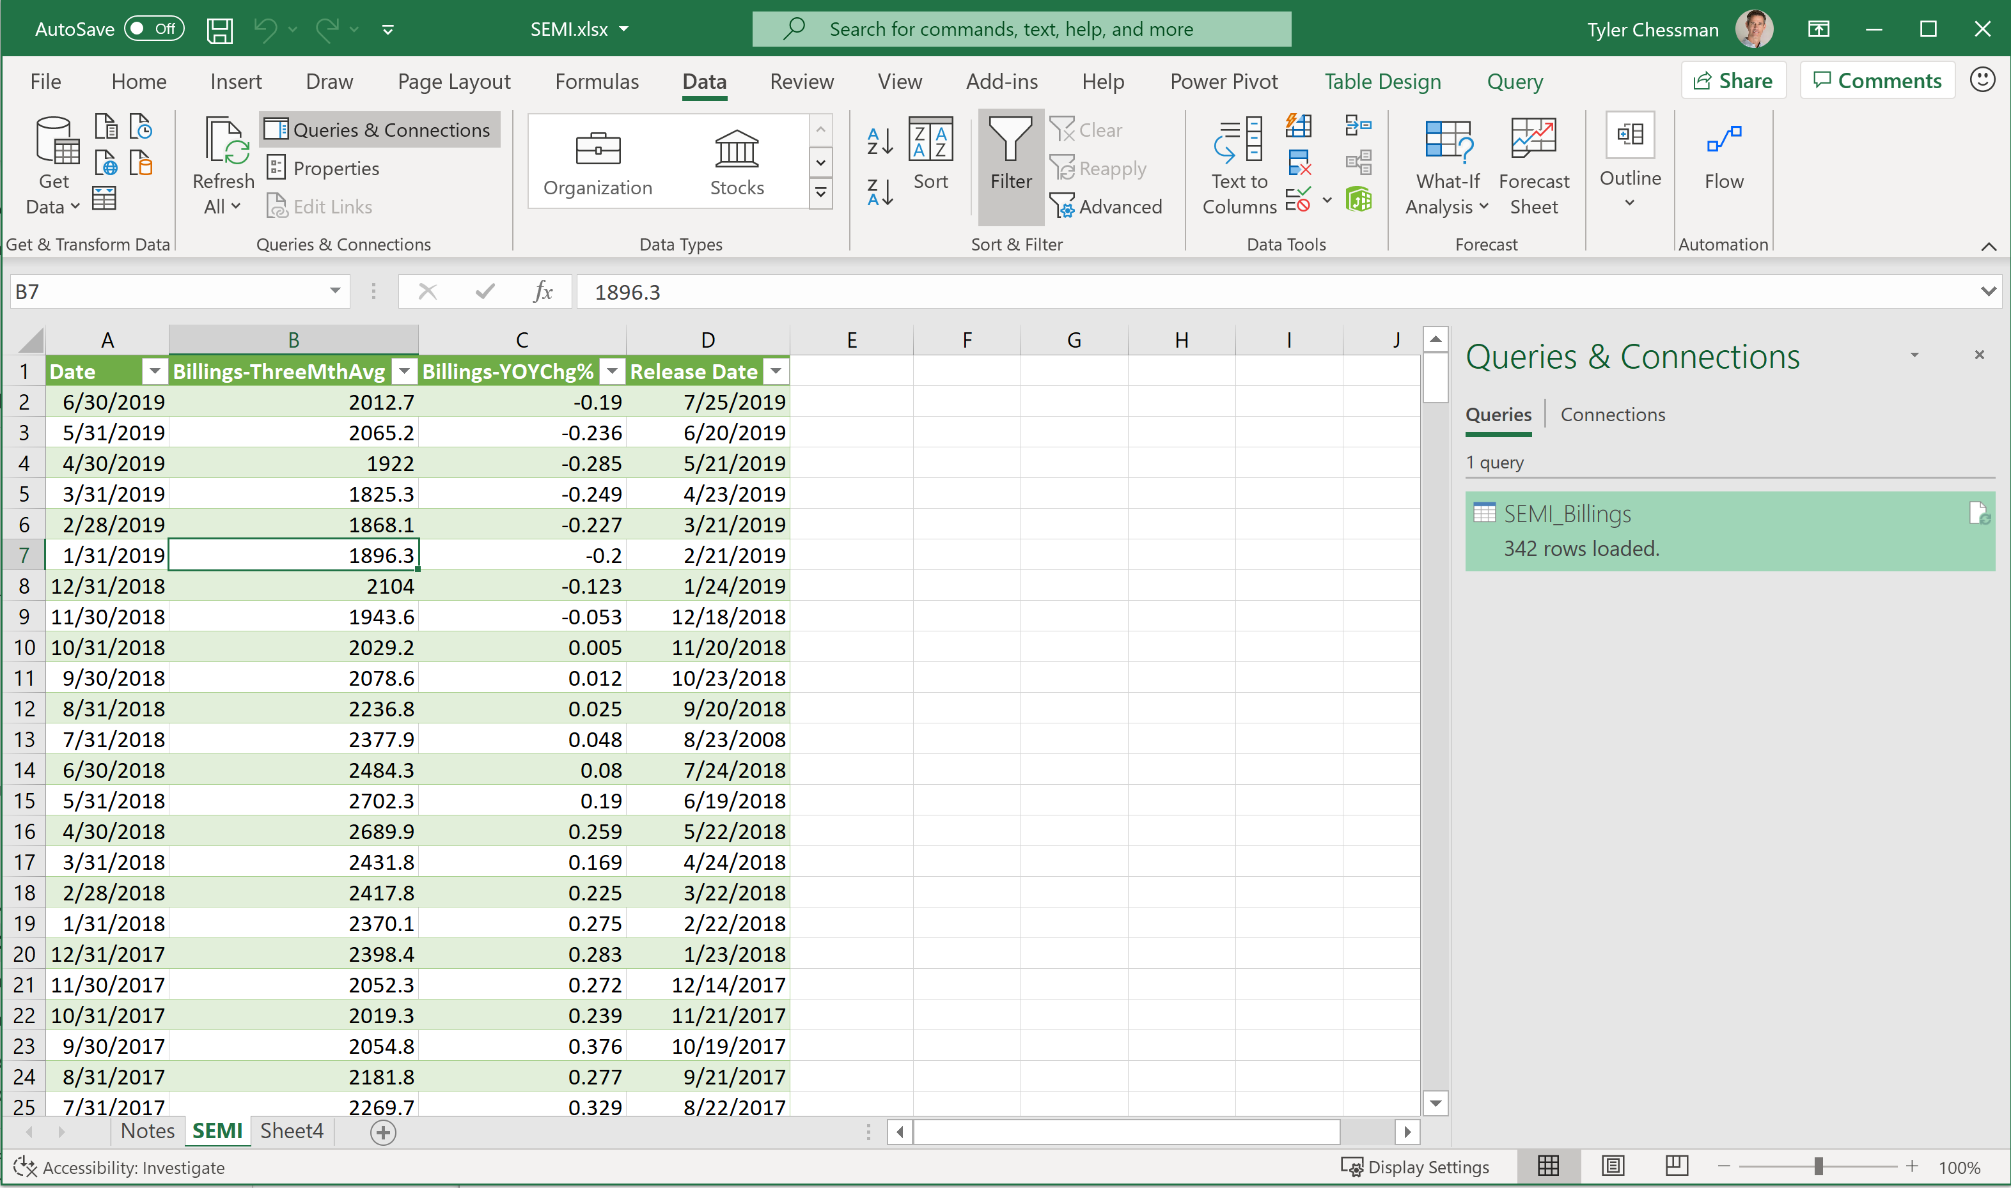
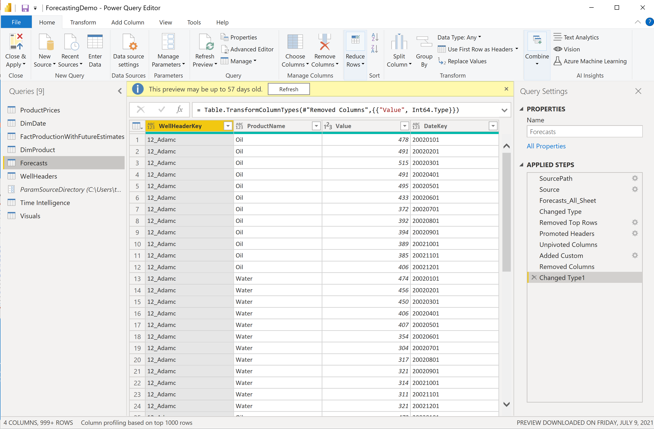
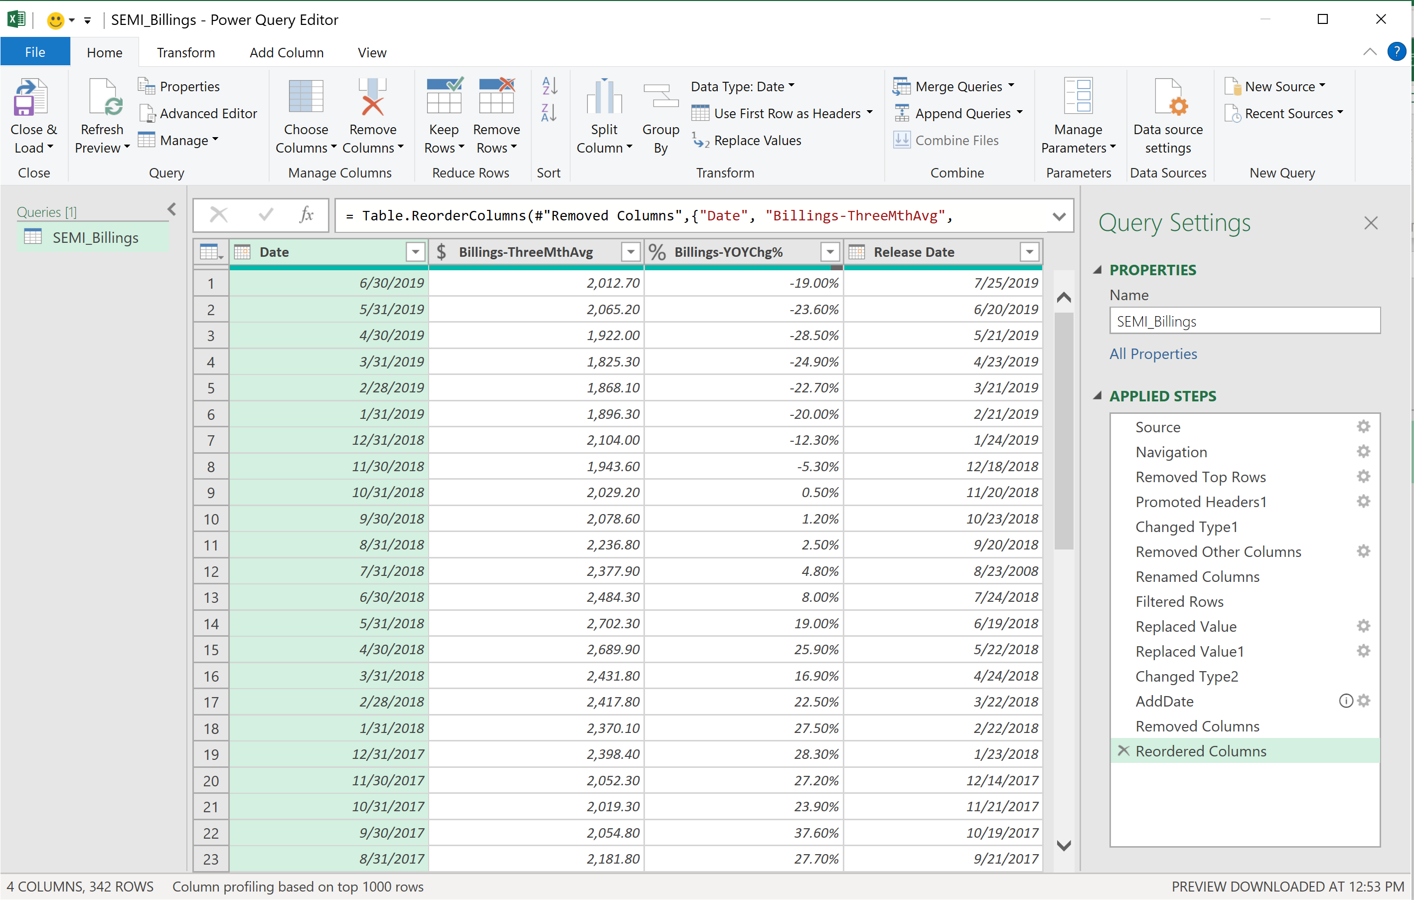
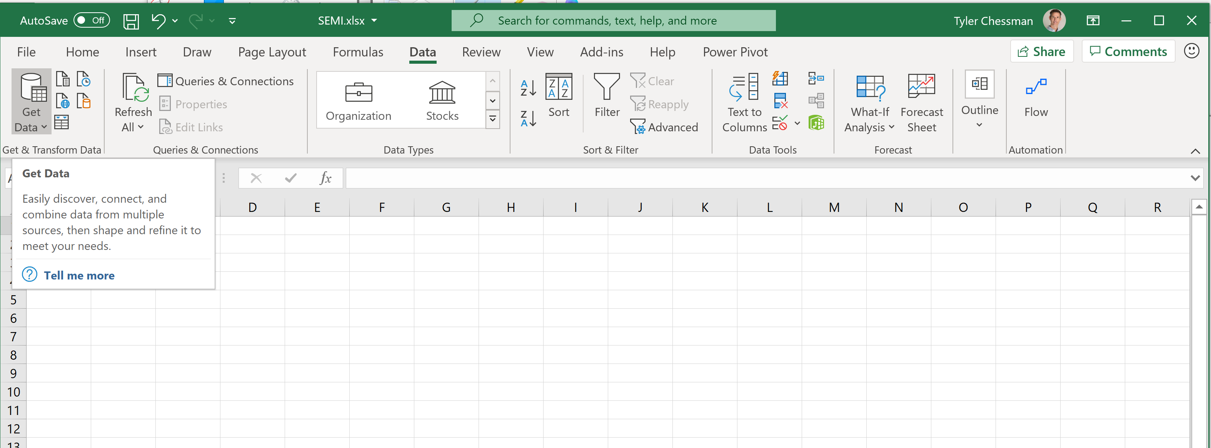
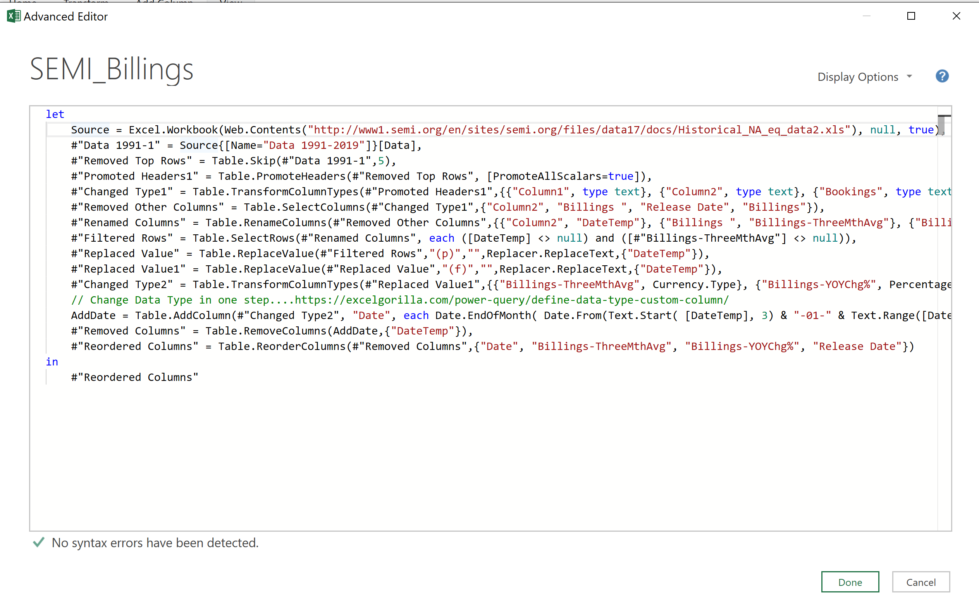
Power Query The Basics
What is it?
A “data connectivity and data preparation technology that enables end users to seamlessly import and reshape data from within a wide range of Microsoft products, including Excel, Power BI, Analysis Services, Common Data Service, and more.”
Originally released as a free add-in for Excel 2010/2013, Power Query is now a native feature within Excel 2016+
Is the native Data Load engine in Power BI (Destkop and Data Flows)
Supports Multiple Data Sources
Provides a graphical UI to Connect and Transform Data
Every “Step” in a Query is part of a script
Viewable from the Advanced Editor
Informally called “M” (James Bond?)
Script can be re-run / scheduled for subsequent data refreshes
Query Results are stored in a worksheet/data model
Load to Data Model for >1 million rows
Other tools (e.g., PBI) load to a different destination
https://docs.microsoft.com/en-us/power-query

Slide 14
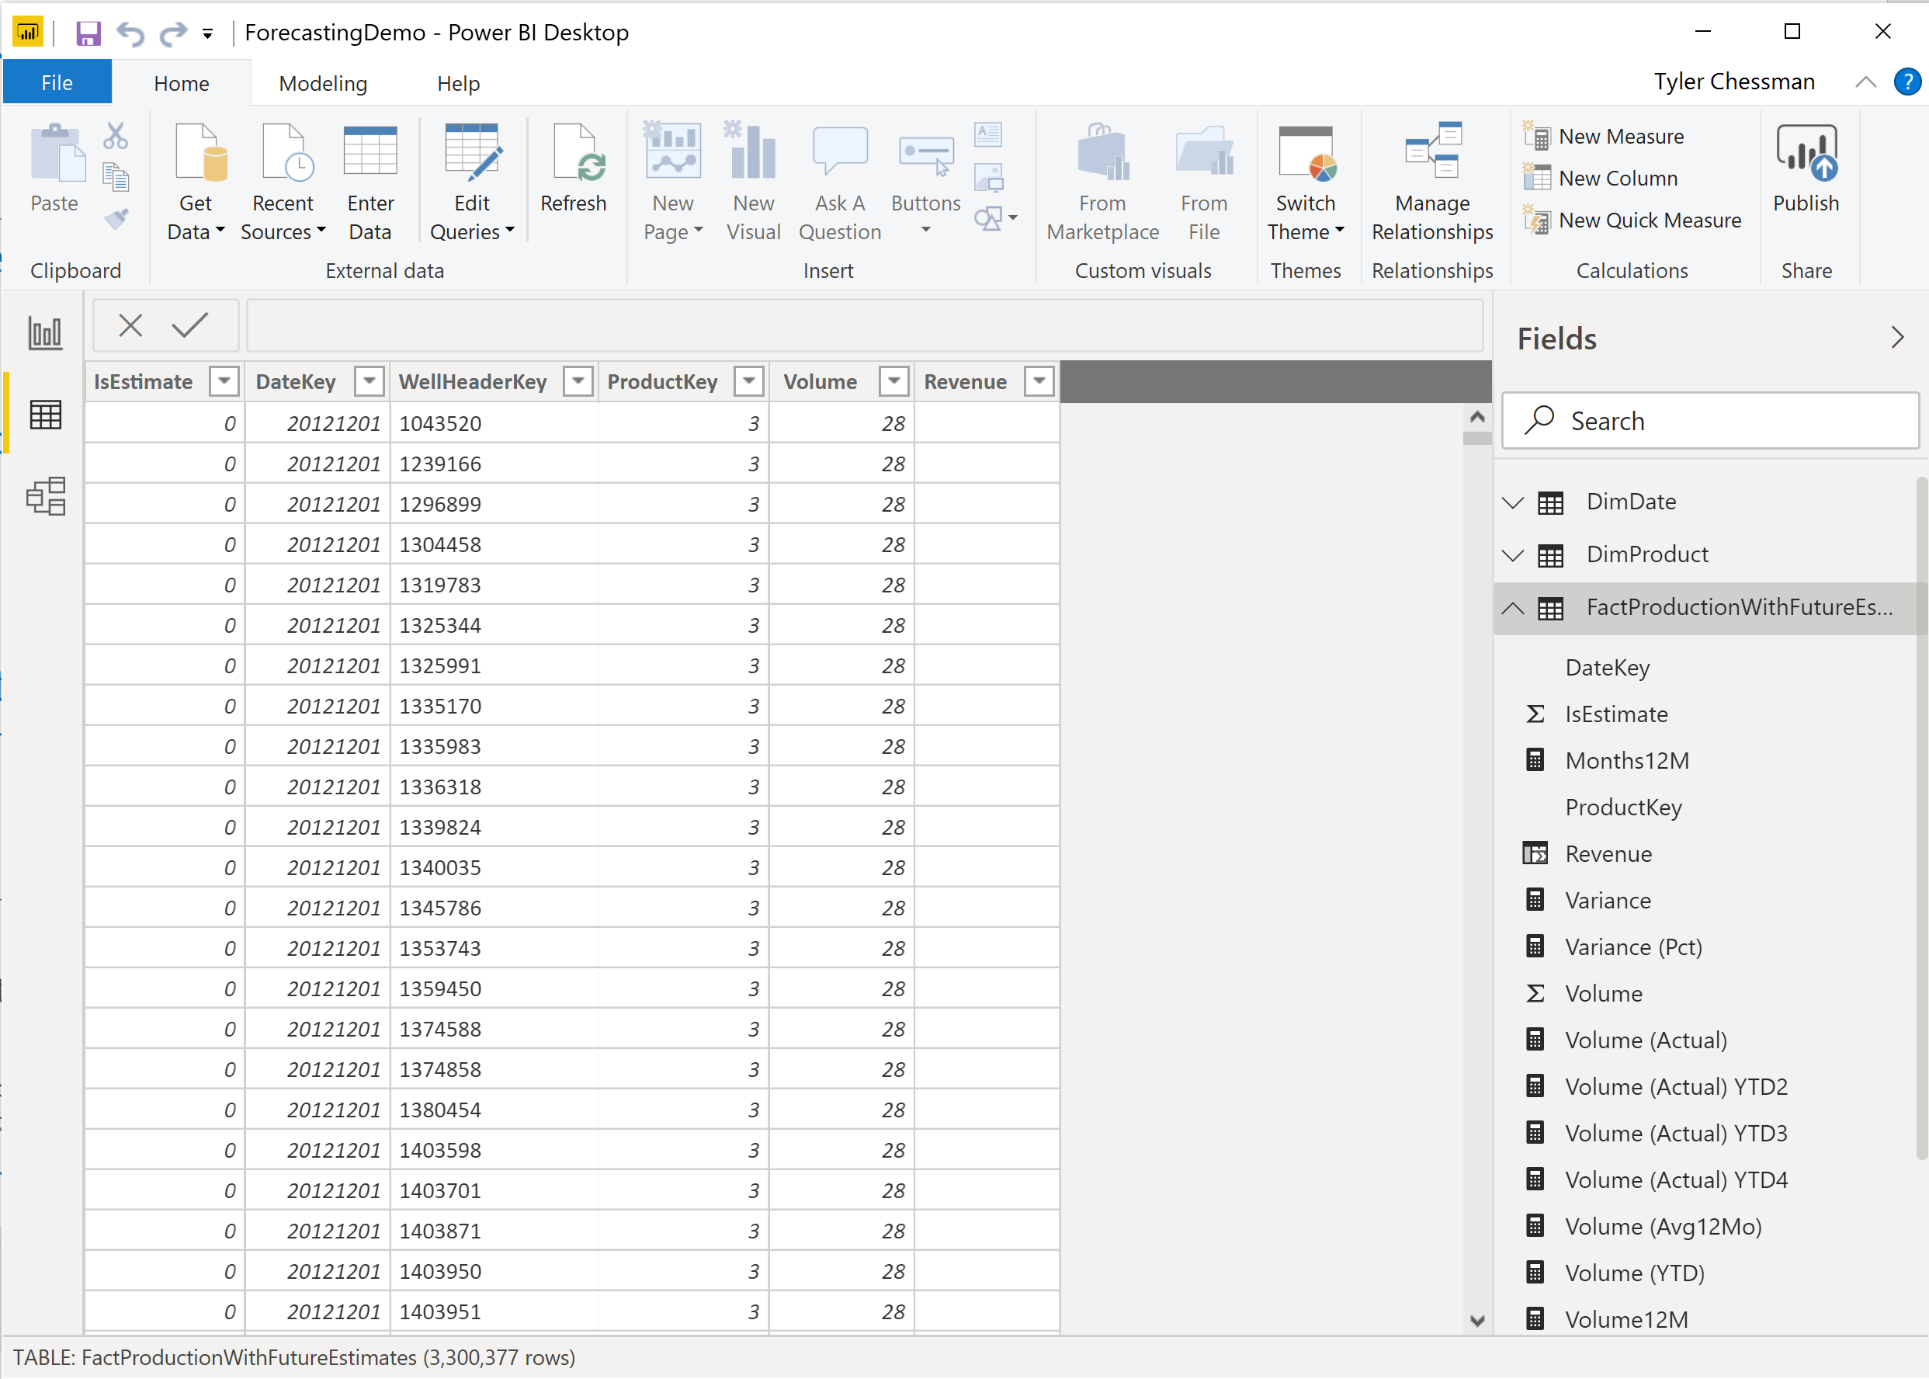
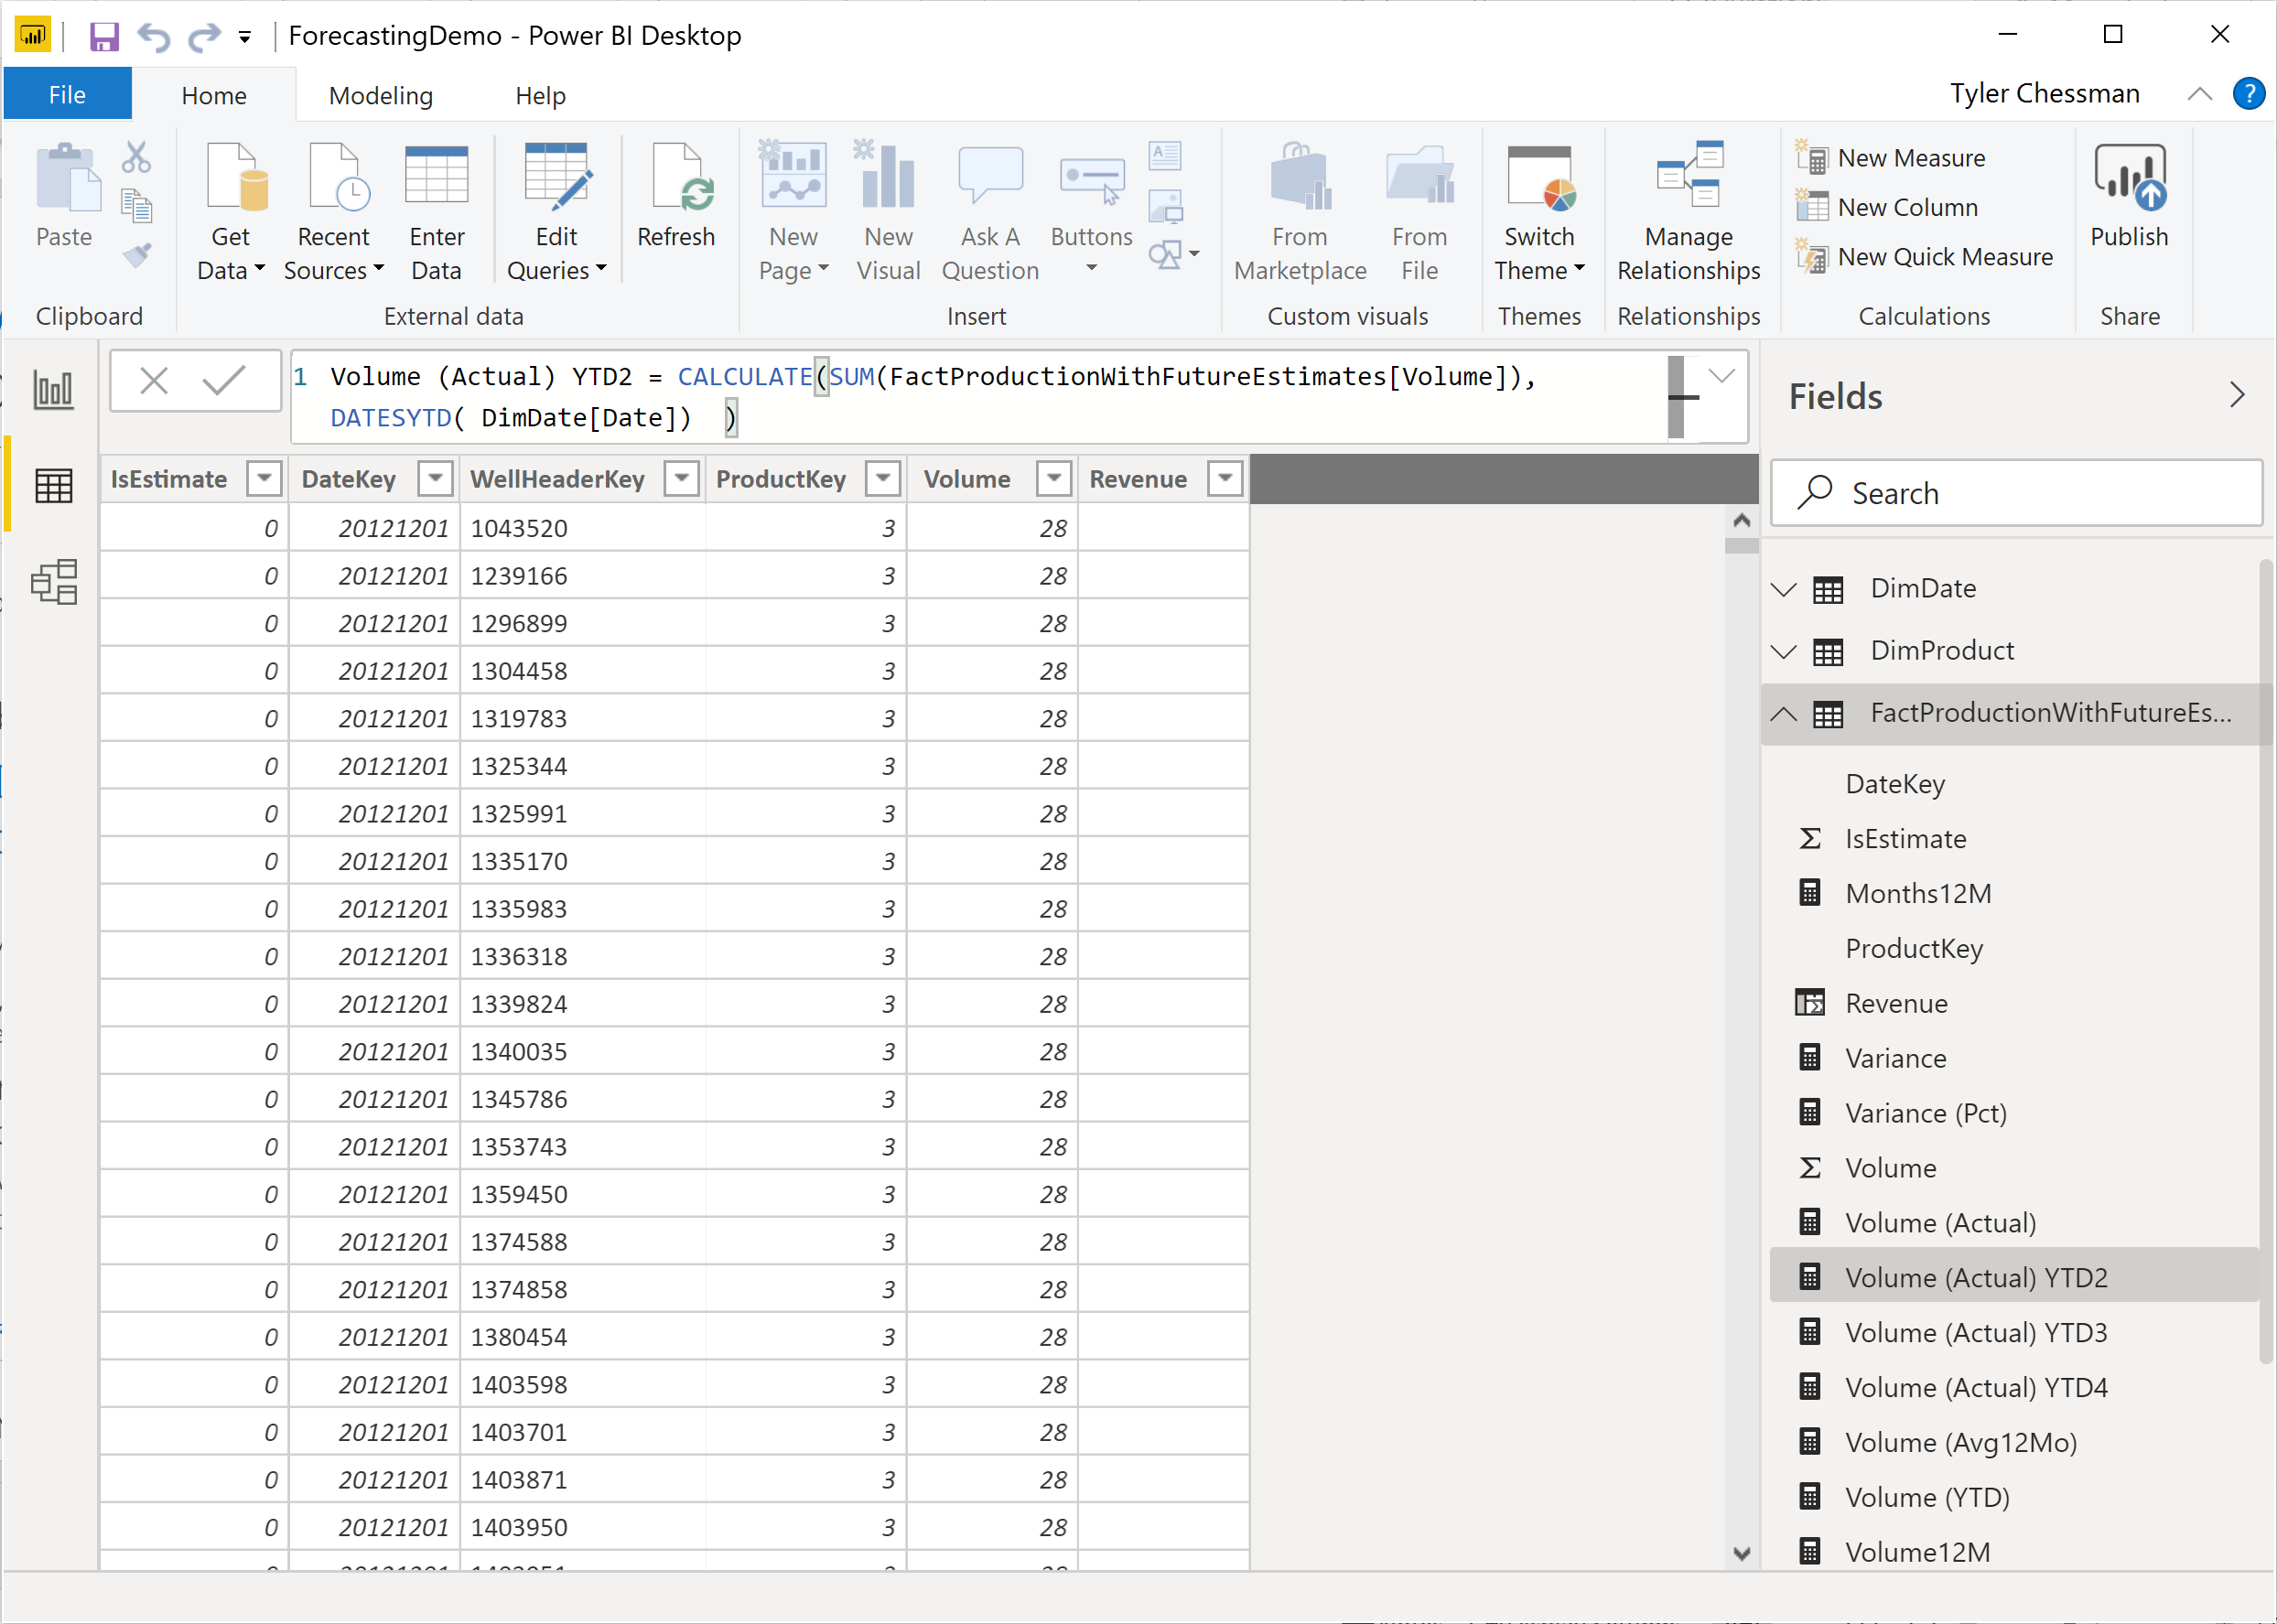
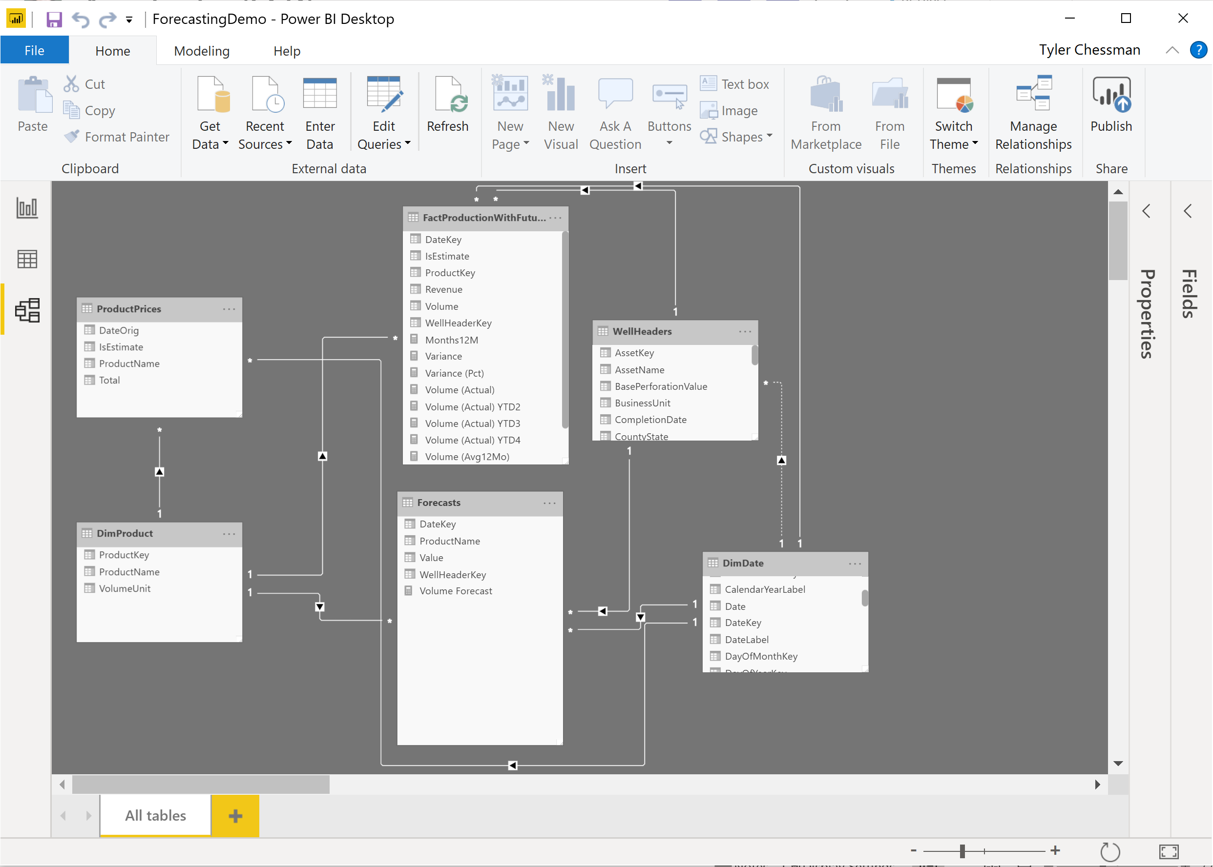
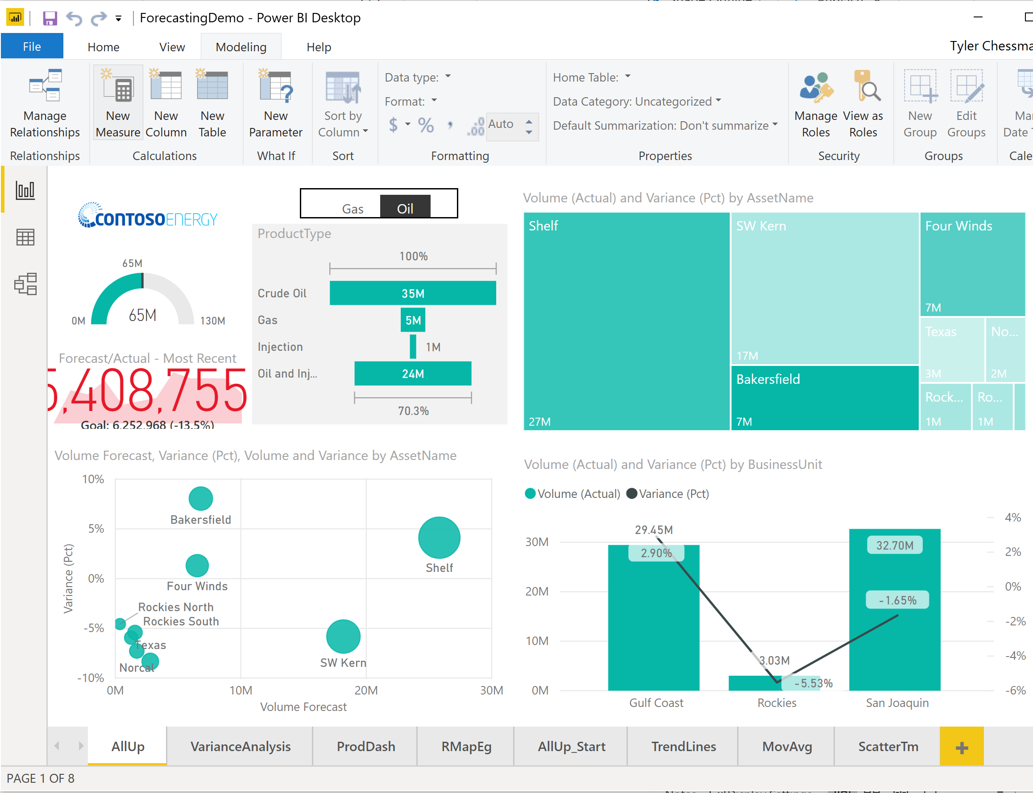
Power BI Authoring Drilldown…. Import, DirectQuery, Connect live
Imported (cached). The author -
Imports data and metadata from data source(s)
May also create calculated columns and measures
Defines relationships among sources
Create a report with 1 or more pages.
Imported data may be refreshed manually or, after publishing, on a schedule (up to 8x in PBI Service, 48x in PBI Premium
Premium also supports incremental refresh
Direct query. The author -
Imports metadata from a data source
May also create calculated columns and measures*
Defines relationships among sources
Creates a report with 1 or more pages.
Every visual is rendered via a real-time query result set.
Once published, a gateway can may be used for on-prem data source
Connect Live. The author -
Connects to a cube/perspective (or Power BI dataset)
May also create additional measures (Tabular only)
*https://docs.microsoft.com/en-us/power-bi/desktop-use-directquery#limitations-of-directquery

Slide 15
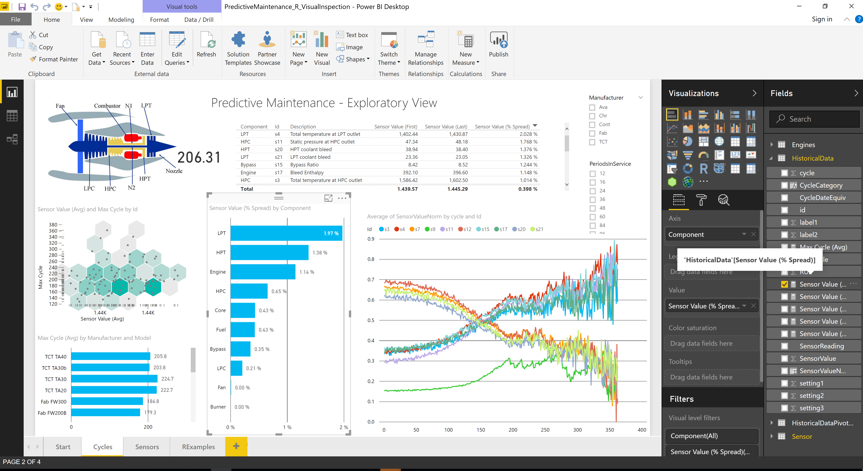
Power BI Authoring Building a Report
In the Desktop, the author chooses columns from the dataset to create tables and charts
A Report is similar to an Excel workbook - it can contain multiple “pages” (worksheets)
Building a report against a live or imported connection is essentially the same experience
The author can save the dataset/report as needed
Everything is saved in a .pbix file
The author can email the .pbix file to someone else, place it on a file share, etc.
Anyone else with the Power BI Desktop can then open/edit it.
Most enterprise organizations will want to “publish” the file for easy consumption..

Slide 16
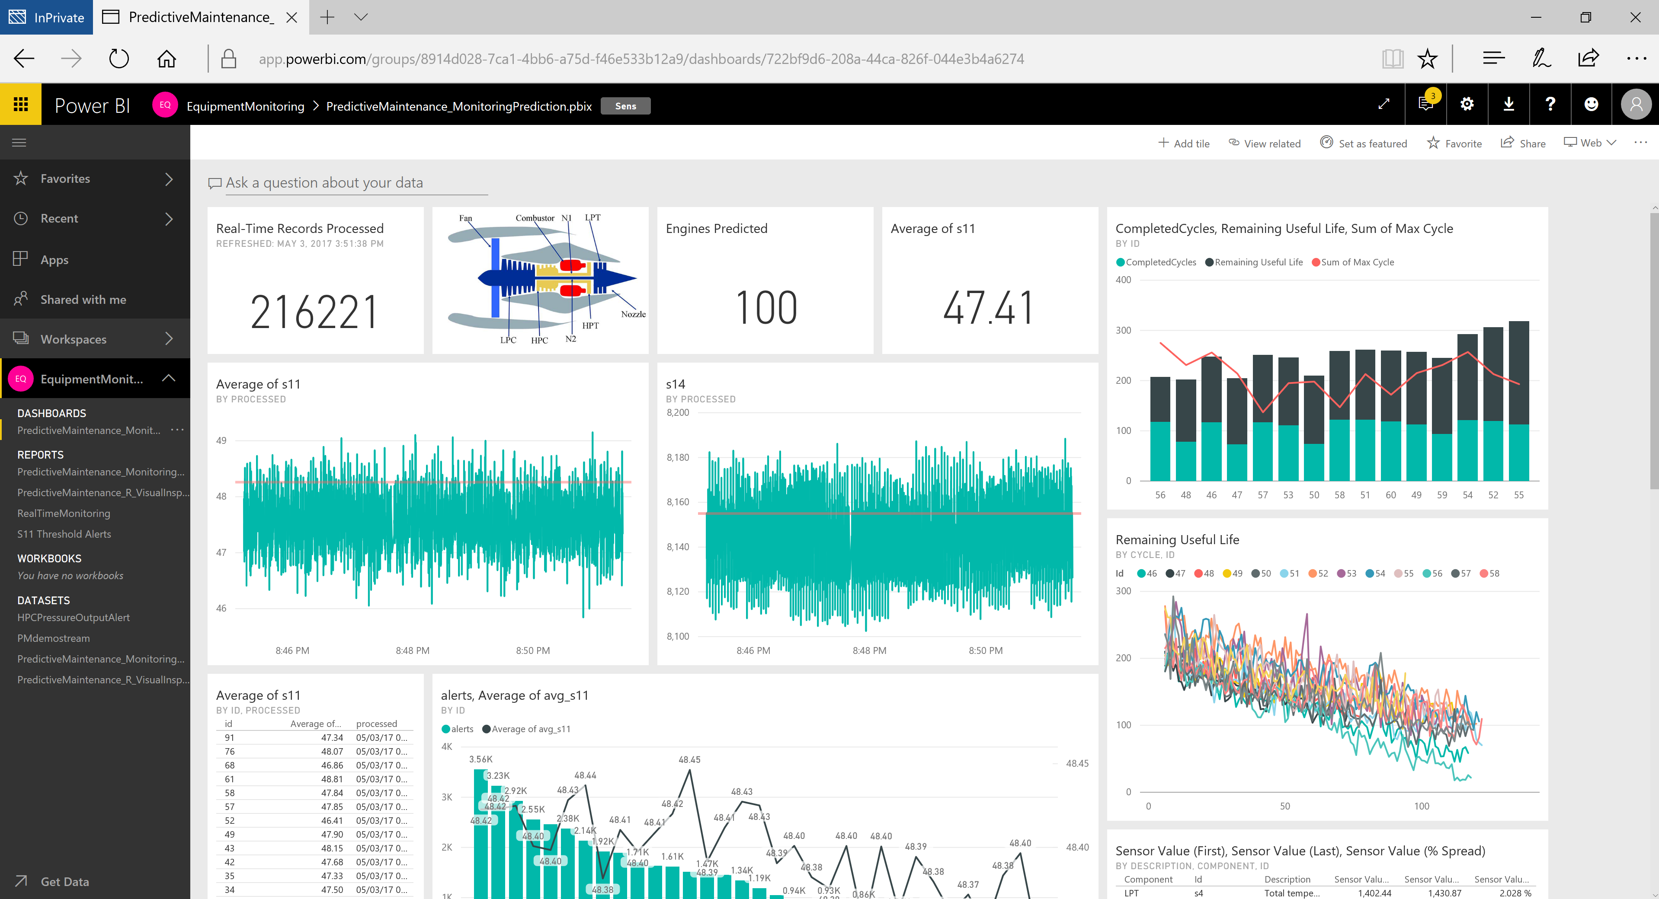
Power BI Authoring Publishing to the Power BI Service
The author publishes the Power BI Desktop file to the Power BI Service
Remember – the .pbix file contains a data set (live or imported) along with a report
These two components (dataset and report) are split out and stored in a workspace
Note – we also support publishing Excel workbooks to the Power BI Service
After the file is published, the author can
Edit and/or create new reports directly in the browser
Schedule data refresh (may require a gateway)
Build a dashboard (a collection of visuals from one or more reports/datasets)
Share the dashboard/report/dataset with others
A note about Workspaces
Every user has a personal “My Workspace”
A user may be a member of other group Workspaces
A Workspace contains Datasets, Reports, and Dashboards
We will cover this in more detail during the publishing topic
Notes:
Power BI data sources - Power BI | Microsoft Docs

Slide 17




Power BI Service Shared Service, Premium, On-Premise Report Server
As of June, 2017….
The Power BI Service is available in both Shared and the new “Premium” mode
Shared Mode
Licensed by user (Pro licenses)
Multiple tenants on shared hardware
Premium Mode
Licensed by user (Pro licenses for authors) and v-cores
Consumers don’t need a Pro license
Update – Per-User license mode
Dedicated hardware
Power BI Service
Shared capacity
CPU/RAM allocation
Power BI Premium / PPU
Sales model 1
Sales model 2
Cluster* capacity
CPU/RAM allocation
Sales model 3
Sales model 1
Other models
Other models
Sales model 2
Other models
Sales model 3
Other models
Other models
➔
Ensure consistent performance
Other models
Other models
Other models
➔
Scale on-demand
Models run on distributed hardware servicing multiple tenants
Company 1
Company 2
Company 3
The Power BI Report Server is available for on-premise deployments
Power BI Desktop files can be published alongside traditional SSRS reports
*Premium Gen2 leverages a regional cluster of physical nodes, shared by tenants using Premium

Slide 18
Power BI Premium Additional Capabilities vs Shared Service
Current (as of Jan 2022)….
Larger Imported Models (100 GB+)
https://docs.microsoft.com/en-us/power-bi/service-premium-large-datasets
Higher dataset refresh rate (48 per day), unlimited via XML/A
Larger Storage Capacity (100 TB)
Incremental refresh (for imported models)
https://docs.microsoft.com/en-us/power-bi/service-premium-incremental-refresh
Geo-specific deployment of Premium capacity
https://docs.microsoft.com/en-us/power-bi/service-admin-premium-multi-geo
Paginated (rdl) reports
Automated Machine Learning
Advanced Dataflows capabilities
Note – New (2021) Premium Per User licensing offers a new way to acquire/use Premium features
Generation 2 architecture, including greater scalability, performance, auto-scale, and reduced management overhead - https://powerbi.microsoft.com/en-us/blog/announcing-the-upcoming-evolution-of-power-bi-premium-to-enterprise-markets-and-beyond/
Planned/Preview (as of Feb 2022)
Hybrid Tables - https://powerbi.microsoft.com/en-us/blog/announcing-public-preview-of-hybrid-tables-in-power-bi-premium/
Automatic Aggregations - https://docs.microsoft.com/en-us/power-bi/admin/aggregations-auto
https://docs.microsoft.com/en-us/power-bi/service-premium
https://docs.microsoft.com/en-us/dynamics365/release-plans/

Slide 19
Datasets Decision Criteria, Capabilities, and Examples
Model Size
< 1 GB
1 GB - 10 GB
10 GB – 400 GB
400 GB +
Refresh Requirements
Daily to 8x a day
Up to 48x daily
Every few minutes
Real-time
PBI Service – 1 GB, 8x daily refresh (full)
PBI Premium – 400 GB, 48x daily refresh (full / incremental), unlimited refresh via XML/A, Scale-out replicas in preview
Azure Analysis Services – 400 GB, unlimited refresh (full / incremental), Scale-out replicas (built-in)
Alternatively supports a limited set of DirectQuery sources
SQL Server Analysis Services – ~4 TB, unlimited refresh, scale-out replicas (custom)
Alternatively supports a limited set of DirectQuery sources
Example Scenarios
I have a 400 MB data set; it needs to be refreshed nightly. Recommendation – PBI Service/Premium
I have a 2 GB data set; it need to be refreshed nightly. Recommendation – PBI Premium
I have a 2 GB data set that needs to be refreshed every 10 minutes. Recommendation – PBI Premium
I have a 25 GB data set; it needs to be refreshed on the hour. Recommendation – PBI Premium / Azure Analysis Services
I’ve developed a report against my relational DW (which is 20 TB). The data is refreshed is throughout the day. Recommendation – DirectQuery, or consider a composite model with Hybrid Tables / aggregations
* Power BI Premium Large Model Support - https://docs.microsoft.com/en-us/power-bi/admin/service-premium-large-models
Notes:
https://docs.microsoft.com/en-us/power-bi/admin/service-premium-what-is

Slide 20
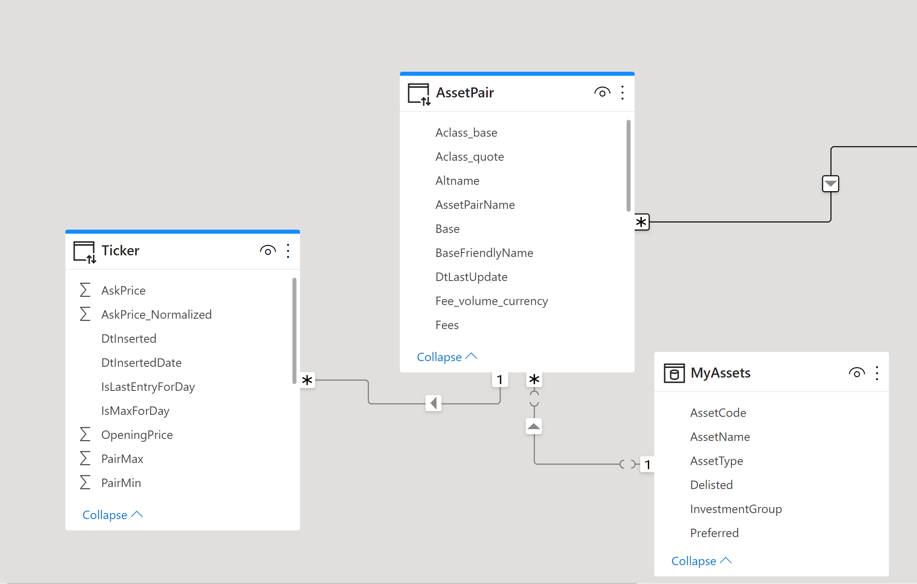
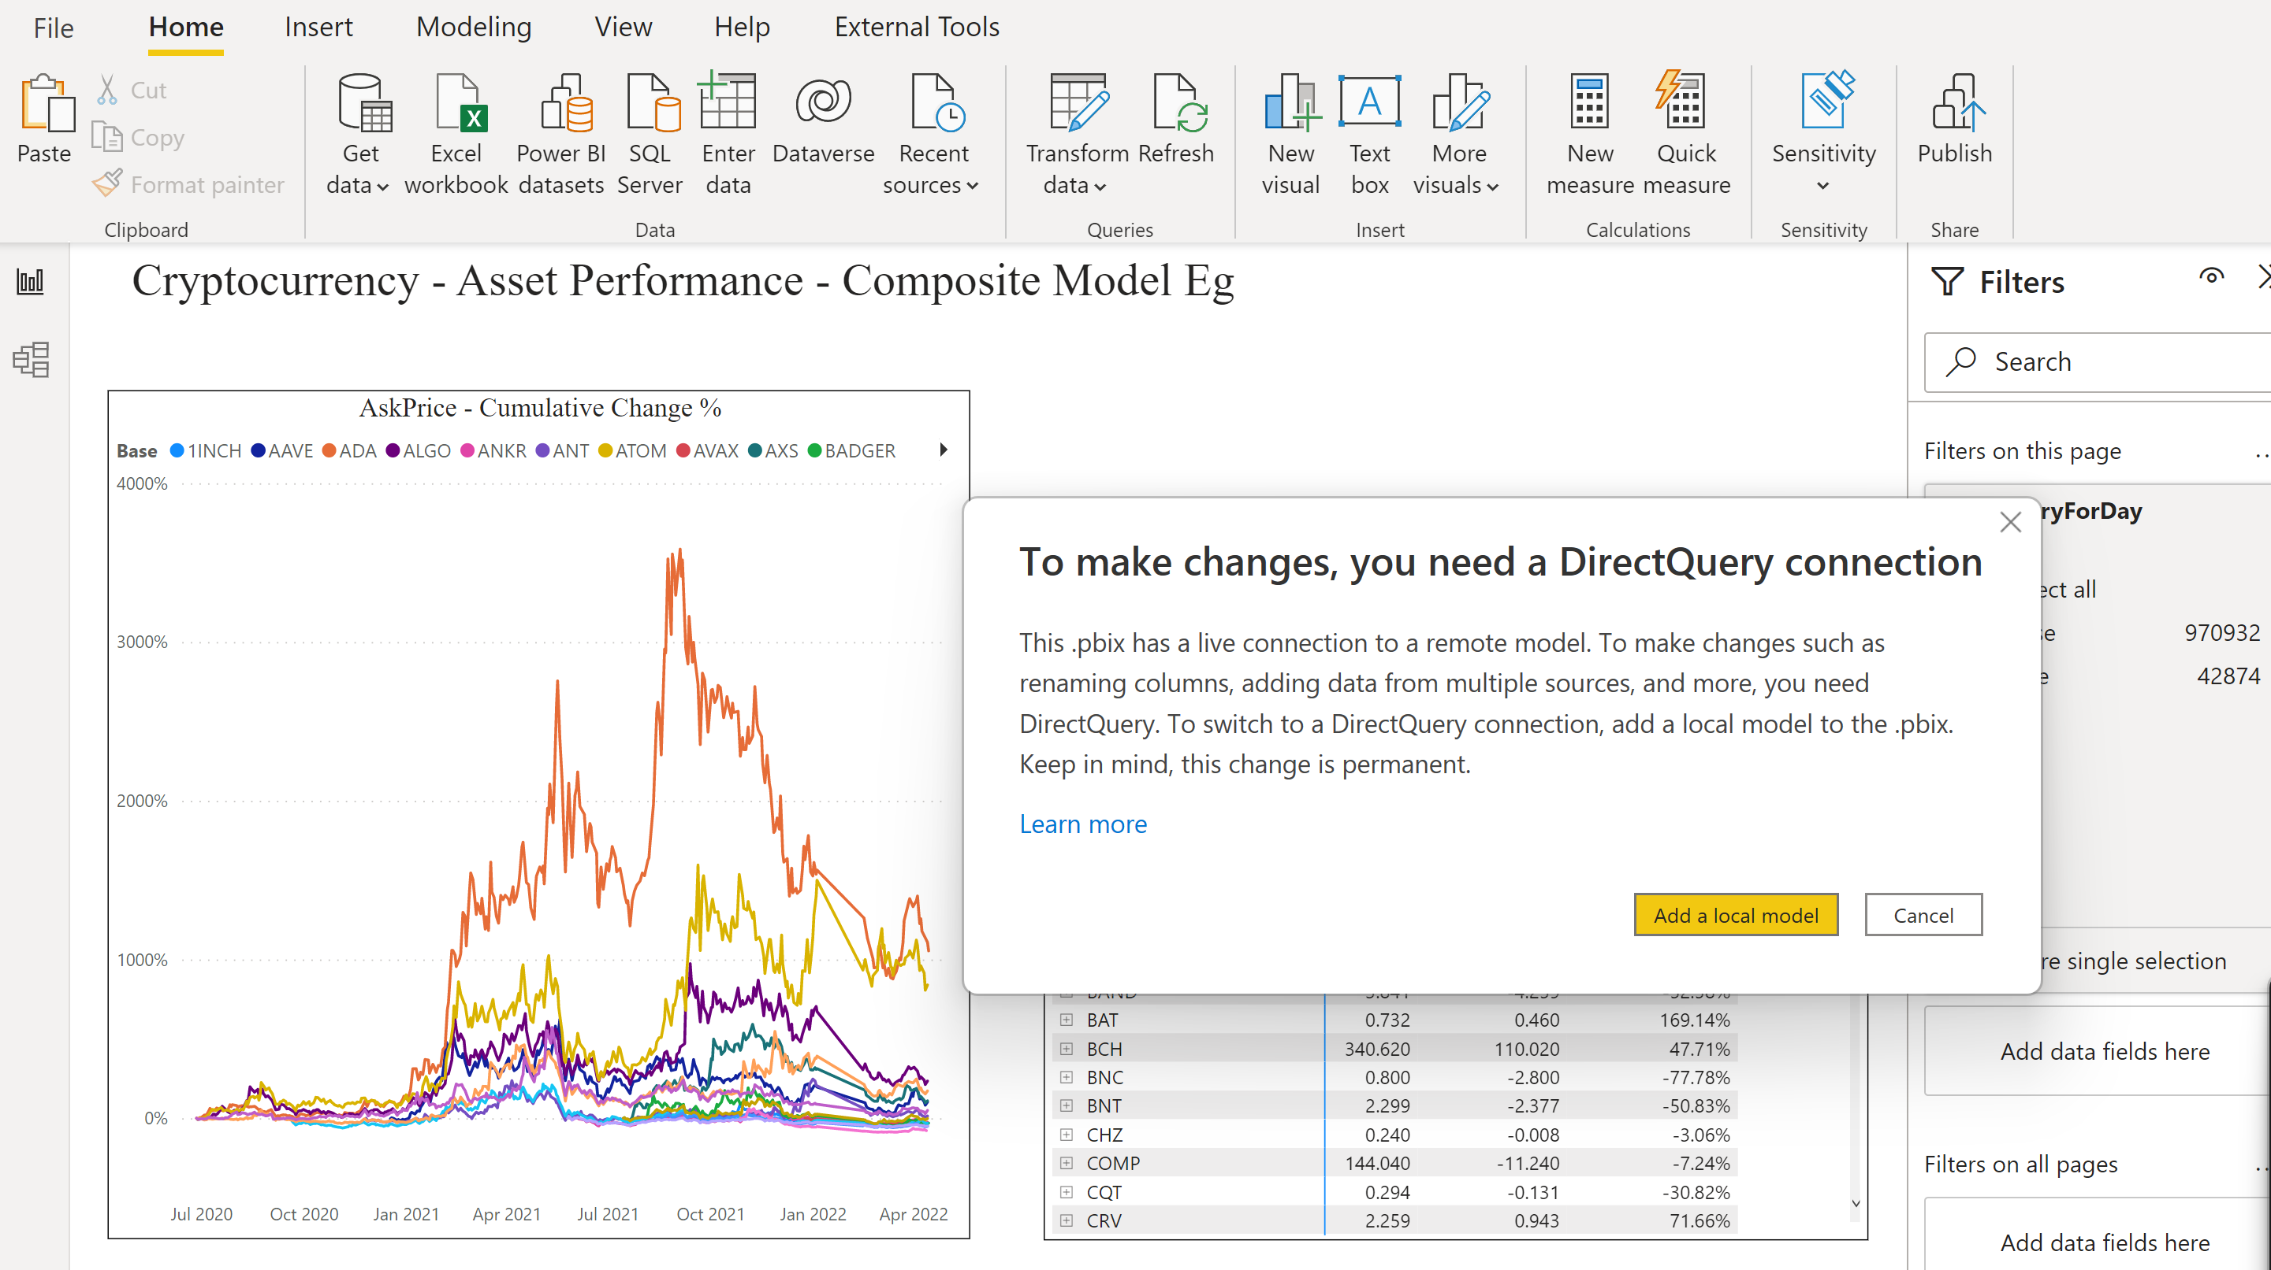
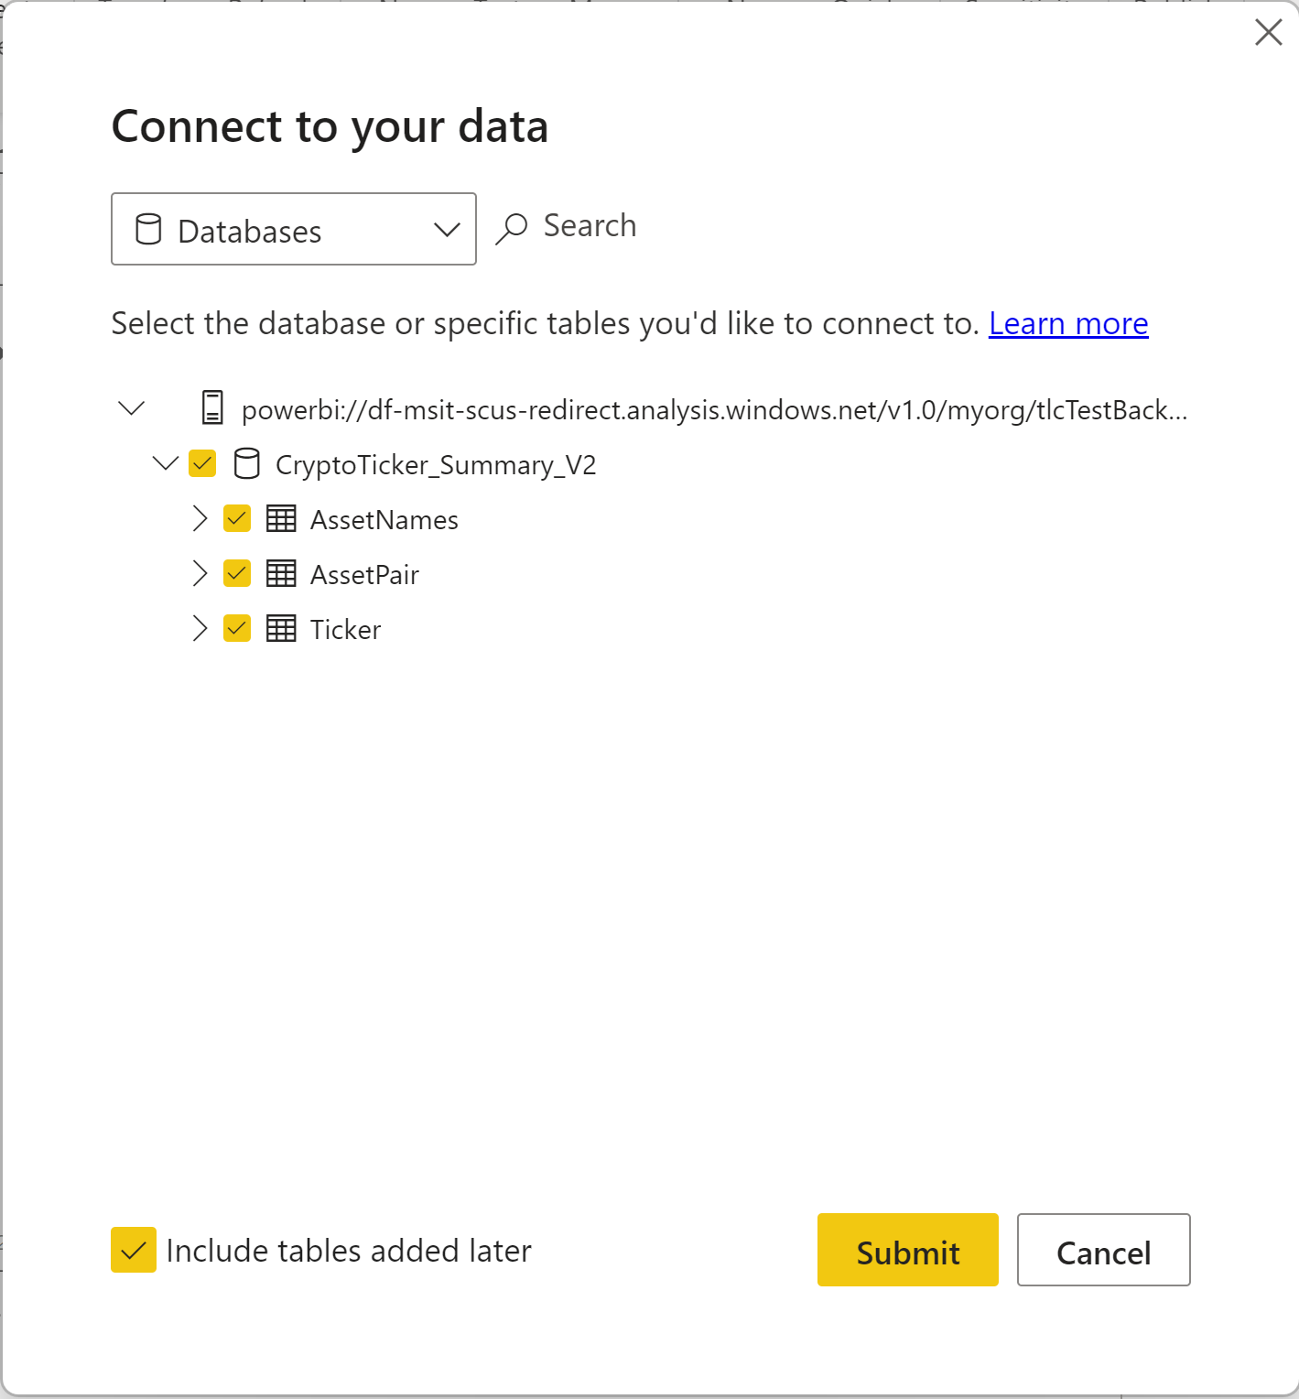
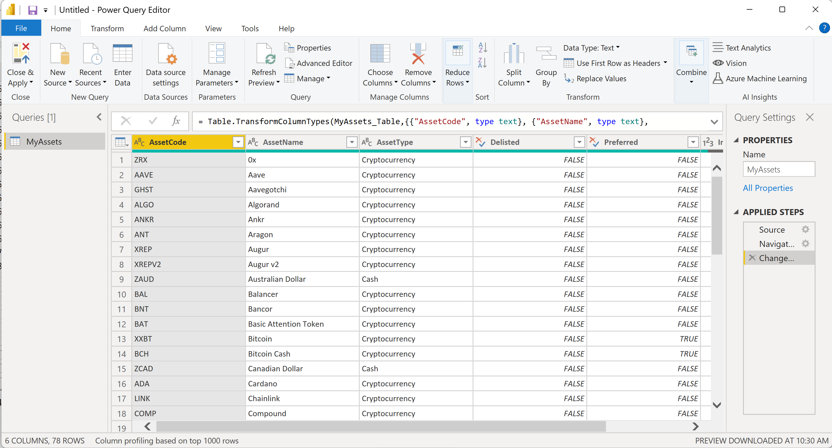
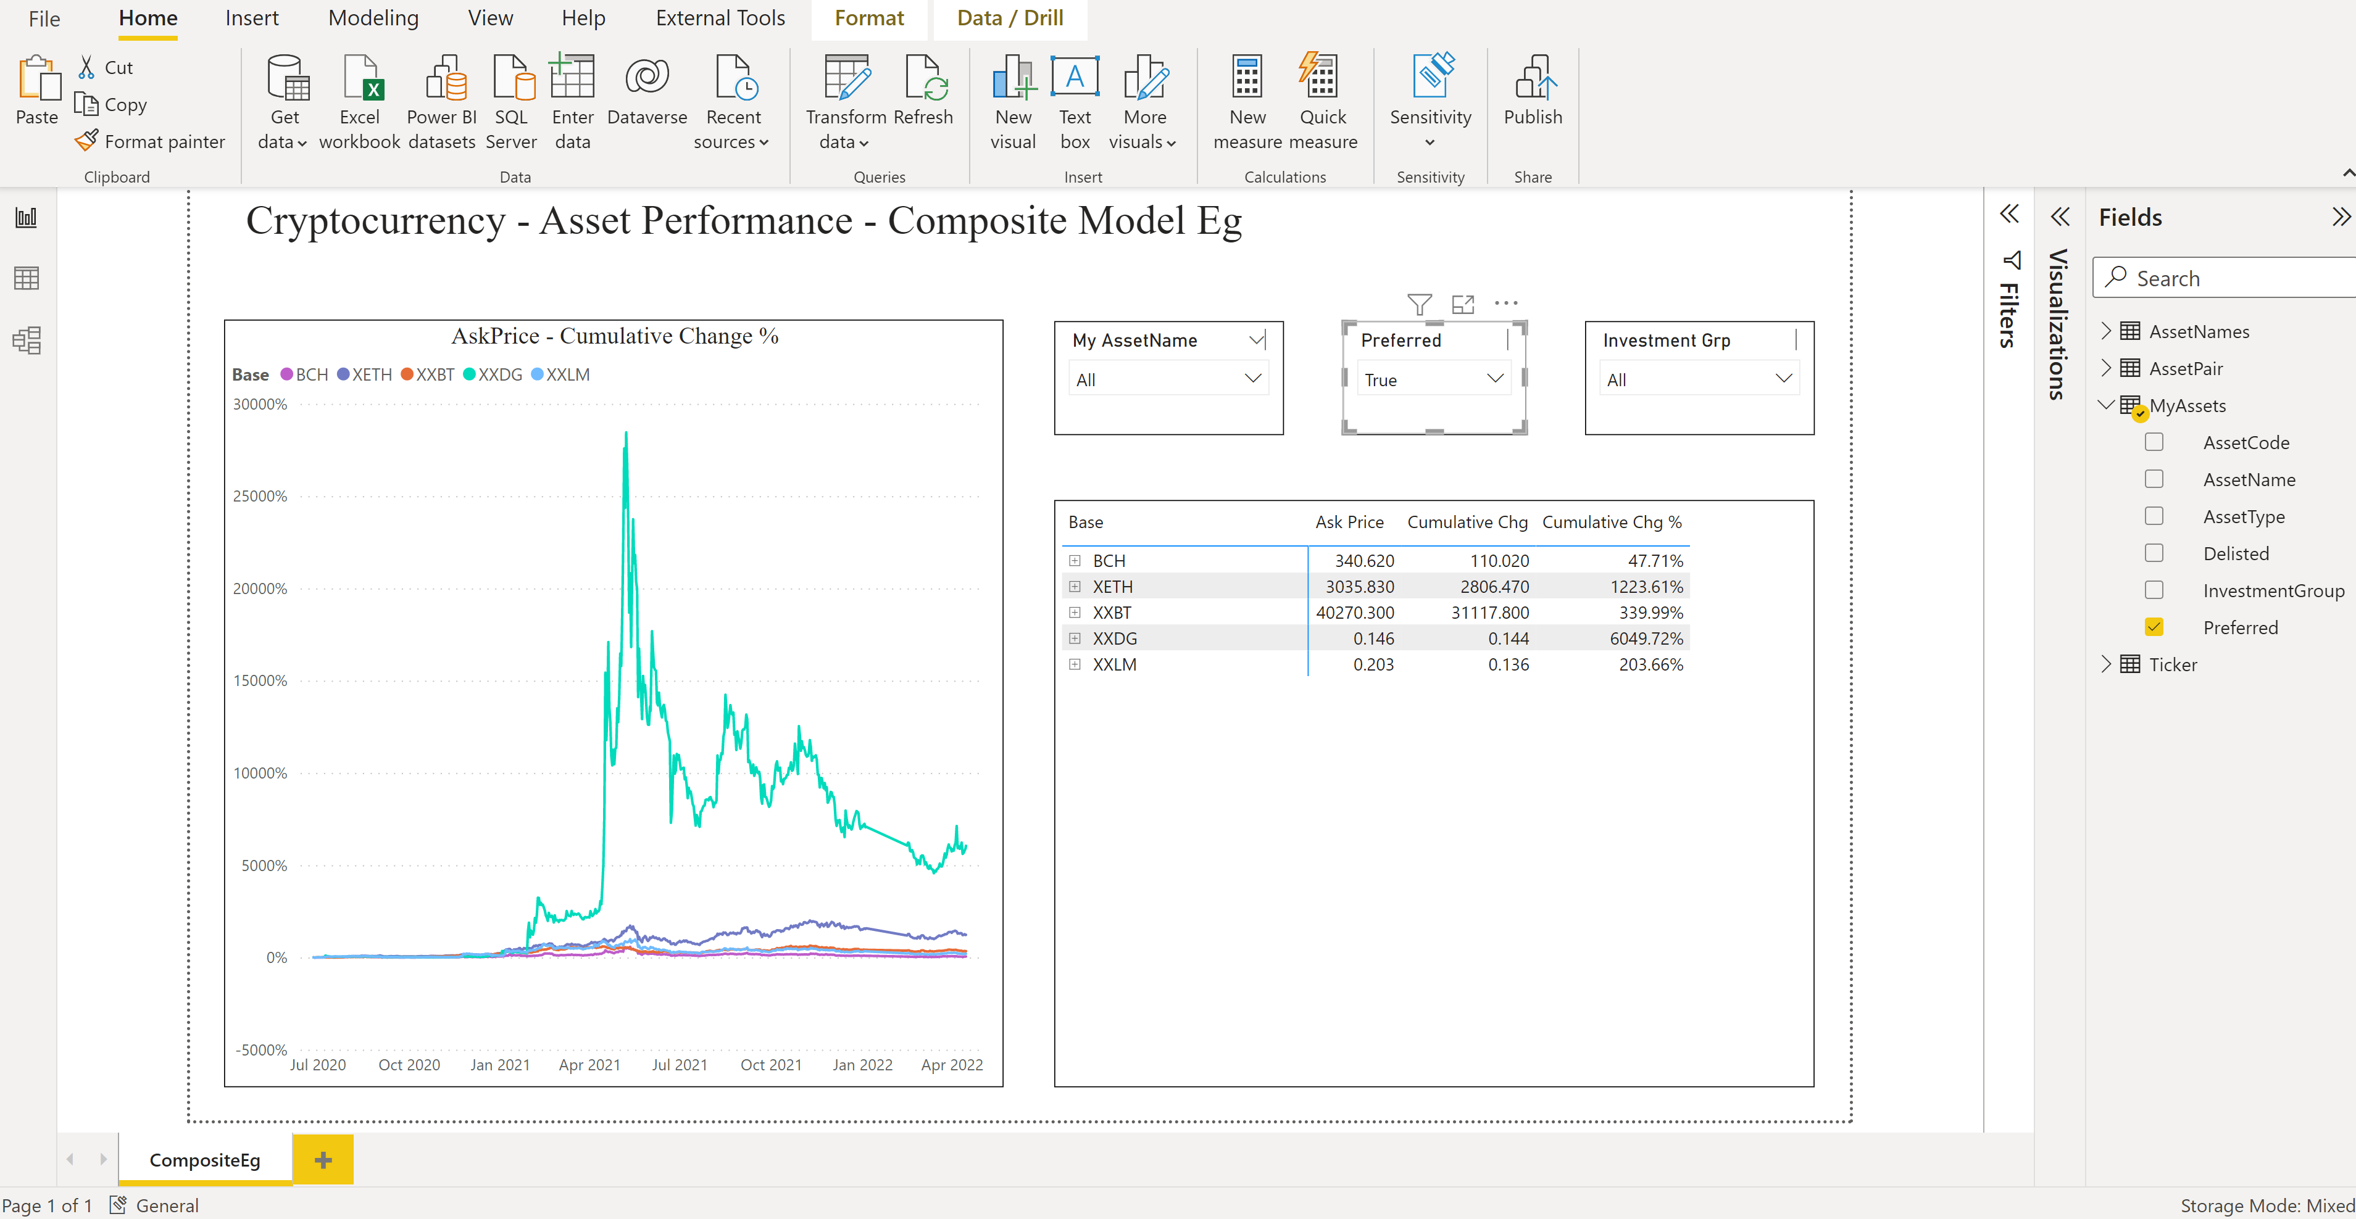
Composite Models Discussion
Definition – A model with a mix of Direct Query and Import Tables
Storage mode (DirectQuery, Import, Dual) allow for optimization of queries
Can combine with User-defined aggregations for additional performance optimization
Common Implementations
Supplement Enterprise Data Warehouse (in DirectQuery) with local “Lookup” table (e.g., an Excel Table)
Supplement AAS/Power BI Dataset with a local table
Note – Still in preview as of Mar 2023 - Using DirectQuery for datasets and Azure Analysis Services (preview) - Power BI | Microsoft Docs
Aspirational* Implementations
Take a Model and then substantially enhance it e.g., adds new fact tables, new dimension tables, etc.
Take multiple models from different subject areas (e.g., Finance, Inventory, Planning) – and let users combine them together to create “conglomerate” models
Combine multiple data warehouses (and maybe a transactional system) together into one model
*Aspirational due to performance and other limitations; see notes on Chaining and Limitations
https://docs.microsoft.com/en-us/power-bi/transform-model/desktop-composite-models
Notes:
https://docs.microsoft.com/en-us/power-bi/admin/service-premium-what-is

Slide 21
DEMO Build/Publish Report

Slide 22
Agenda
Introductions and Expectations for the Day
Architectural Overview of Power BI
Roles/Responsibilities
Provisioning of Services, Users, & Software
Training and Evangelism
Managing/Exposing Data Sources
Publishing and Sharing Content - Best Practices
Supporting Data Refresh and Live Connections
Security Best Practices
Monitoring and Auditing activity

Slide 23
Roles and Responsibilities Common Areas/Tasks and role mappings
Business Sponsor
Azure AD administrator
Office 365 Global Admin
Provisioning
dependent services, software, licenses
Training and Education
Basic on-boarding, how-to’s, company standards, tips/tricks, knowledge sharing
Data Access and Usage
Approved sources, master data, sharing and publishing policies
Authoring
Creating/connecting to datasets, creating reports
Publishing
Open to all or some, approval process required
Sharing
Individual versus teams vs corporate wide
Securing
Data (at-rest & in-transit; on-premise & cloud), authentication/authorization
Monitoring and Auditing
Publishing, Creating, Sharing, Exporting, and Deleting of content
Power BI Champion
Data Steward
Power User/Analyst
BI Practitioner/IT Developer
BI Architect
Security Architect
Power BI Administrator

Slide 24
Provisioning Dependent Services
Azure AD administrator
Office 365 Global Admin
Azure Active Directory (Azure AD, AAD)
Required for user authentication – used by a variety of 3rd party & Microsoft services – Office 365, Exchange Online, SharePoint Online, Power BI, etc.
In Power BI, AD security groups can also be used to help securing/distributing content to end-users.
Large enterprises will synchronize their on-premise Active Directory with Azure AD to provide a single sign-on experience
AAD Connect - https://docs.microsoft.com/en-us/azure/active-directory/connect/active-directory-aadconnect
Action Item - Check with your internal Domain Administrators/Security Team to determine the current state of AAD integration
Office 365
Technically, Power BI doesn’t require Office 365 licensing. But, it does use Office 365 artifacts/management capabilities
The Office 365 Admin portal is also used for license management (you can use Power Shell scripting as well)
Many organizations already have some Office 365 licensing in place
Action Item – Find out if your organization is using Office 365, and contact the Office 365 Global Admin
The Office 365 Global Admin has administrative rights over Power BI, but he can delegate a “Power BI Service Administrator” role
“Your account needs to be marked as a Global Admin, within Office 365 or Azure Active Directory, or have been assigned the Power BI service administrator role, to get access to the Power BI admin portal.”
https://powerbi.microsoft.com/en-us/documentation/powerbi-admin-administering-power-bi-in-your-organization/
https://powerbi.microsoft.com/en-us/documentation/powerbi-admin-role/ . Note, this role does not provide….
Ability to modify users and licenses within the Office 365 Admin Center
Access to the audit logs (though Power BI now offers its own view of PBI Specific logs! More on this topic later)

Slide 25
Provisioning Users and Software
Azure AD administrator
Office 365 Global Admin
Power BI Admin
Power BI Champion
Power BI Desktop - https://powerbi.microsoft.com/en-us/desktop/
The authoring tool for Power Users/IT Developers (and anyone else who is going to author and publish content)
A free application, it has no dependency on the Power BI Service; requires local administrative rights to install on a machine
Updated monthly – though you don’t have to install every update; some organizations are choosing to perform controlled quarterly rollouts
E.g., https://blogs.msdn.microsoft.com/samlester/2016/09/30/installing-power-bi-desktop-through-sccm/
Action Item – Develop Power BI Desktop rollout and update strategy
Power BI Gateway – covered later
Power BI Service – data center location*
https://www.microsoft.com/en-us/trustcenter/privacy/powerbi-location
Power BI Service – User Licenses
By Default, users can self-sign up for a Power BI Free license
The free license is now severely limited – no sharing capabilities. Free license users can automatically bump themselves up to a 60-day Pro trial
Action Item – Consider blocking individual sign up - https://powerbi.microsoft.com/en-us/documentation/powerbi-admin-powerbi-free-in-your-organization/. Instead, assign licenses in mass or as part of an employee on-boarding process
Power BI Pro (or PPU) licenses are required for any users who want to publish/share/modify content.
To view shared content, a user will also need a Pro license – unless that content is published to a workspace hosted in a Premium capacity
Action Item – Identify end-user community of authors and consumers. Look at licensing/pricing, and evaluate against performance requirements
https://powerbi.microsoft.com/en-us/pricing/
Notes:
*

Slide 26
Training and Evangelism Role out strategy
Power BI Champion
BI Architect
Identify Training Needs
Power Users – Gather/Store Data, Build Data Models, Build Initial Reports, Publish Content, Share Content
Consumers – Find Content, Explore Dashboards/Reports (extend dashboards/reports?)
Administrators – Today!
Build Internal Awareness for the masses
Present and record internal presentations/webinars (~1.5 hours) – conduct multiple times and make available for on-demand viewing
Consider Hands-On Training for Power Users
Dashboard in a Day Sessions often held at local Microsoft Offices e.g., https://www.microsoftevents.com/profile/form/index.cfm?PKformID=0x188356617d4
See Next Slide for Online, Classroom, Books, and Self-Paced training options
Conduct “Launch” Event(s)
A repeat of internal awareness content along with Testimonials/internal case studies
Call to actions (any training materials/follow up sessions)
Update (April 2021) – See my COE document for additional ideas - tylerchessman/PBICOE: Guidance for establishing a Power BI Center of Excellence (github.com)
Business App Summit, Schlumberger PBI Rollout - https://www.youtube.com/watch?v=yKRdZW5WUVY
~starts at 26 minutes into video, deployment approach at ~34

Slide 27
Training Links and Resources
Power BI Champion
Microsoft provides several free training resources and virtual labs (train yourself):
Getting Started with Power BI - https://powerbi.microsoft.com/en-us/learning/
YouTube Video Library - https://www.youtube.com/channel/UCy--PYvwBwAeuYaR8JLmrfg.
Power BI Documentation - https://powerbi.microsoft.com/en-us/documentation/powerbi-landing-page/
July, 2021 – free 60-minute virtual training sessions - Announcing availability of virtual workshops and training to get started with Power BI | Microsoft Power BI Blog | Microsoft Power BI
Contact your local Microsoft sales team to learn more about customized training options – for Admins, Power Users, and End-users
Training/learning from 3rd party sources
www.sqlbi.com. Deep expertise on Tabular, Multidimensional, PowerPivot, and DAX. Provide both books and online training. Recommend signing up for their newsletters
Bluegranite. http://msbiacademy.com/
www.powerpivotpro.com. https://p3adaptive.com/.
Artis Consulting. Great boutique MSFT BI consulting shop that also offers training www.artisconsulting.com
Pragmatic Works. Free and paid training, along with workshops, (http://pragmaticworks.com)

Slide 28
Agenda
Introductions and Expectations for the Day
Architectural Overview of Power BI
Roles/Responsibilities
Provisioning of Services, Users, & Software
Training and Evangelism
Managing/Exposing Data Sources
Publishing and Sharing Content - Best Practices
Supporting Data Refresh and Live Connections
Security Best Practices
Monitoring and Auditing activity

Slide 29
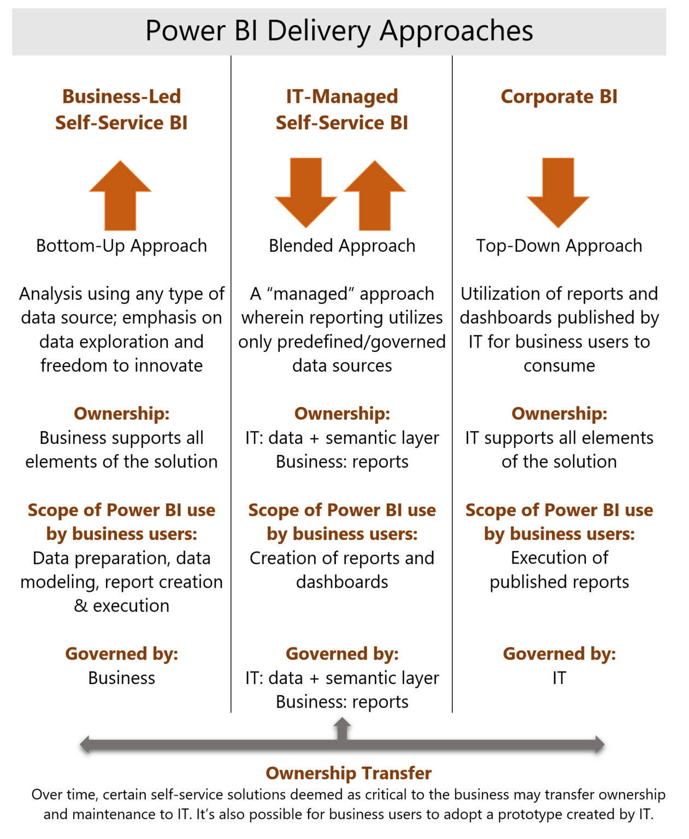
Governance Overview
Definition
“Establishment of policies, and continuous monitoring of their proper implementation, by the members of the governing body of an organization. It includes the mechanisms required to balance the powers of the members (with the associated accountability), and their primary duty of enhancing the prosperity and viability of the organization.” - www.businessdictionary.com/definition/governance.html
It is useful to think about governance in the context of three delivery approaches and corresponding levels of control.
Business-Led Self-Service BI. Business (typically Power) Users -
Have direct access to data (Gather/Store)
The ability to create custom data models (Model) and reports (Analyze)
Publish data model and reports (Share)
IT-Managed Self-Service BI.
IT gathers/stores/models and publishes a data model
Business users build reports and share with others
Corporate BI
Typically a “turn-key” solution. IT delivers a ready-to-consume dashboard
Additional reports/authored tightly controlled
*New content (June 2021) available - https://docs.microsoft.com/en-us/power-bi/guidance/powerbi-adoption-roadmap-governance
Notes:
In the PBI Adoption roadmap: Content ownership and management article…
-Ownership is broken out into 1) Business-led self-service BI, 2) Managed Self-Service, and 3) Enterprise BI
In the Content-Delivery Scope article, 4 scopes are identified
1) Personal, 2) Team, 3) Departmental, and 4) Enterprise BI

Slide 30
Governance Key Points and Considerations
Policies
Limit the number of people who can write to and read from the data lake (e.g., developers, data engineers, data scientists)
Develop and implement a consistent data lake taxonomy / storage strategy e.g.
Data Lakes Purposes, Practices, Patterns and Platforms By Philip Russom
https://docs.microsoft.com/en-us/azure/data-lake-store/data-lake-store-best-practices#directory-layout-considerations
https://www.sqlchick.com/entries/2017/12/30/zones-in-a-data-lake
Use a data “catalog” to enable search, discovery, annotation, and surfacing of data sources/elements
Define a process to identify data sources available for analysis – and the steps/workflow that needs to be followed when publishing/sharing data with others (next slide)
Implement a data warehouse based on classic dimensional modeling / fact tables for downstream analytics
Use AAD for authentication
Where applicable, implement RLS to securely filter data (RLS can be re-used by downstream tools e.g., AS, PBI, etc.
Monitoring
Azure Monitor for all-up monitoring
Tool-specific monitoring (e.g, Data Lake, Synapse)
Power BI Tenant-Level Settings & Auditing/Monitoring (covered later)

Slide 31


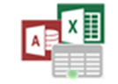
Governance Example Process
1
Data Sources
6
PowerBI.com
Master Data & Data Quality
1
Add New Reporting Data Source
Shared Data Sources
Shared Datasets
Reports and Dashboards
App Workspaces / Apps
2
Perform Data Source Security and Governance Management Tasks
2
Data Governance Stewards
Big Data/Data Lake
Security, Roles, Data Sources, Data Catalog, Master Data Version Control and Audit
3
Publish Approved Shared Data Source for Analysts/Power Users
4
Develop Reporting Content with Approved Shared Data Sources
Cloud Apps, Streams & IoT Data
3
Approved Secure Shared Data Sources, Datasets
via Data Gateway / Workspaces
7
Submit Reporting Content for Approval
based on Governance Guidelines
5
Approval Workflow to Deploy
6
Review, Approve/Disapprove, Add to Catalog for Compliance and Audit
Data Warehouse & App Databases
4
8
5
7
Publish Approved Content with Permissions to Groups
8
View and Explore Power BI Content based on Role/Group Permissions
Power BI Desktop,
Excel, R, Azure ML & other tools
Analysis Services
BI Semantic Models
Analysts/Power Users
Self-Service BI Users
Notes:
Ad-hoc discussions about approaches to introducing governance into an environment that has traditionally been lightly governed.

Slide 32
Governance Introducing into an existing environment
Review the new Governance documentation, specifically, Method 1
Be sure to review the Considerations and key actions
Low hanging fruit – Tenant Settings Tenant settings guidance - Power BI | Microsoft Docs e.g.,
Share content with external users
Publish to web
Export data
Monitoring – Audit Logs
Capture key events (e.g., Export data, data source/gateway usage, etc.)
Monitoring – Inactive Usage e.g.,
Power BI Unused Artifacts API (preview) | Microsoft Power BI Blog | Microsoft Power BI)
Custom Scripts/Jobs
Introduce Sensitivity Labels (Microsoft Information Protection sensitivity labels in Power BI - Power BI | Microsoft Docs)
Uses Azure Information Protection Premium P1/P2
Allows users to classify content (Desktop and Service)
Can be applied to datasets, reports, dashboards, and dataflows
Labels apply to exported data/.pbix files
Notes:
Ad-hoc discussions about approaches to introducing governance into an environment that has traditionally been lightly governed.

Slide 33
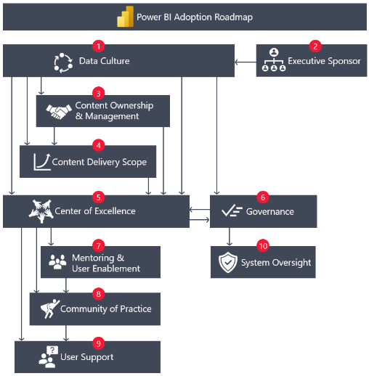
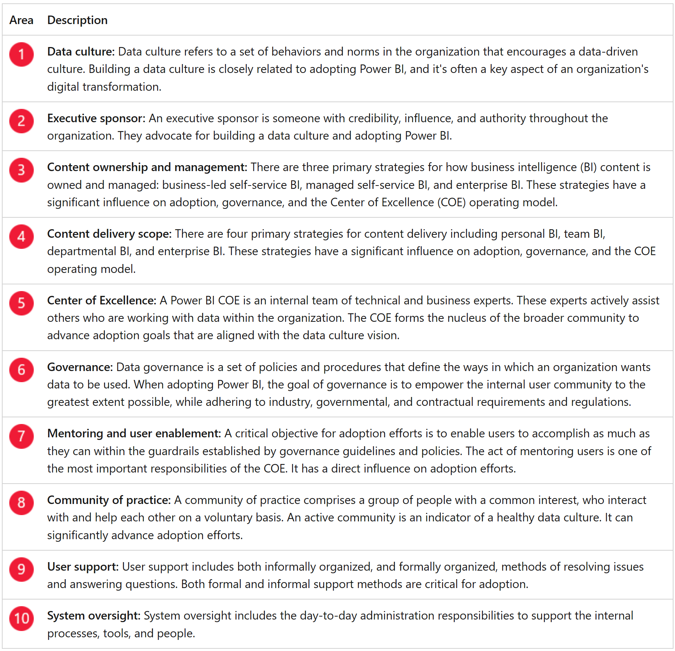
Power BI Adoption Roadmap Building a Center of Excellence
https://learn.microsoft.com/en-us/power-bi/guidance/powerbi-adoption-roadmap-overview

Slide 34
Center of Excellence (COE) Getting Started – Establish an initial Definition, for your Organization/Business Unit
An internal team of technical and business experts … assists others within the organization who are working with data .. forms the nucleus of the broader community to advance adoption goals, which align with the data culture vision
Power BI Adoption Roadmap
A business function that organizes people, processes, and technology components into a comprehensive set of business competencies and capabilities.
Microsoft’s BI COE
Developed by building connections and creating partnerships, establishing regular touch points, and focusing on user enablement. Internal communities bring people together by finding internal champions, connecting with PBI user groups and the PBI team at Microsoft, and local partners.
How Rockwell Automation is building a world-class Power BI Center of Excellence – YouTube
Helps businesses “maximise the benefits realisation, fast track the ROI, provide an all-around greater experience” while minimizing risks and downsides …. guidelines and best practices to help the organization leverage all of the PBI Platform benefits (existing and new) – while ensuring a “safe, controlled, and governed environment”.
Alex Garcia, Power BI Centre of Excellence, What and Why – Part 1 of PBI COE Series. – Smart Power BI
A team who provides leadership, best practices, resources, and guidelines to help an organization maximize the benefits of Power BI in a safe, controlled environment.
Tyler Chessman - COE Guidance

Slide 35
Center of Excellence (COE) Create an Implementation Plan – Define Goals
Define Goals
Scope Responsibilities
Staff Team
Build and Empower the community
Potential Goals Include:
Evangelize a data-driven culture.
Promote the adoption and value of using Power BI.
Nurture, mentor, guide, and educate internal users to increase their skills and level of self-reliance.
Coordinate efforts and disseminate knowledge across organizational boundaries.
Create consistency and transparency for the user community, which reduces friction and pain points related to finding relevant data and analytics content.
Maximize the benefits of self-service BI, while reducing the risks.
Reduce technical debt by helping make good decisions that increase consistency and result in fewer inefficiencies.
Action Item
With a COE definition in place, identify key goals along with a justification as to why a COE is needed – and the risks of not having one.

Slide 36
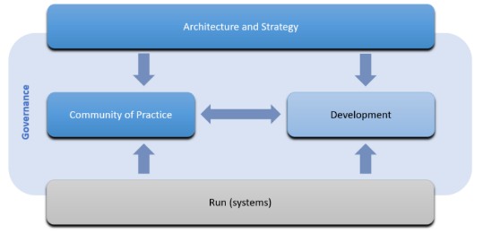
Center of Excellence (COE) Create an Implementation Plan – Scope Responsibilities
Define Goals
Scope Responsibilities
Staff Team
Build and Empower the community
Common responsibilities include:
Mentoring the internal Power BI community.
Producing, curating, and promoting training materials.
Creating documentation and resources to encourage consistent use of standards and best practices.
Applying, communicating, and assisting with governance guidelines. For more information, see the Governance article.
Handling and assisting with system oversight and administration. For more information, see the System oversight article.
Responding to user support issues escalated from the help desk. For more information, see the User support article.
The scope of the COE includes architecture and strategy guidance, community enablement, governance, development , and run (monitoring, troubleshooting, licensing)
Scoping a Power BI Centre of Excellence – Part 3 of PBI CoE Series. – Smart Power BI

Slide 37
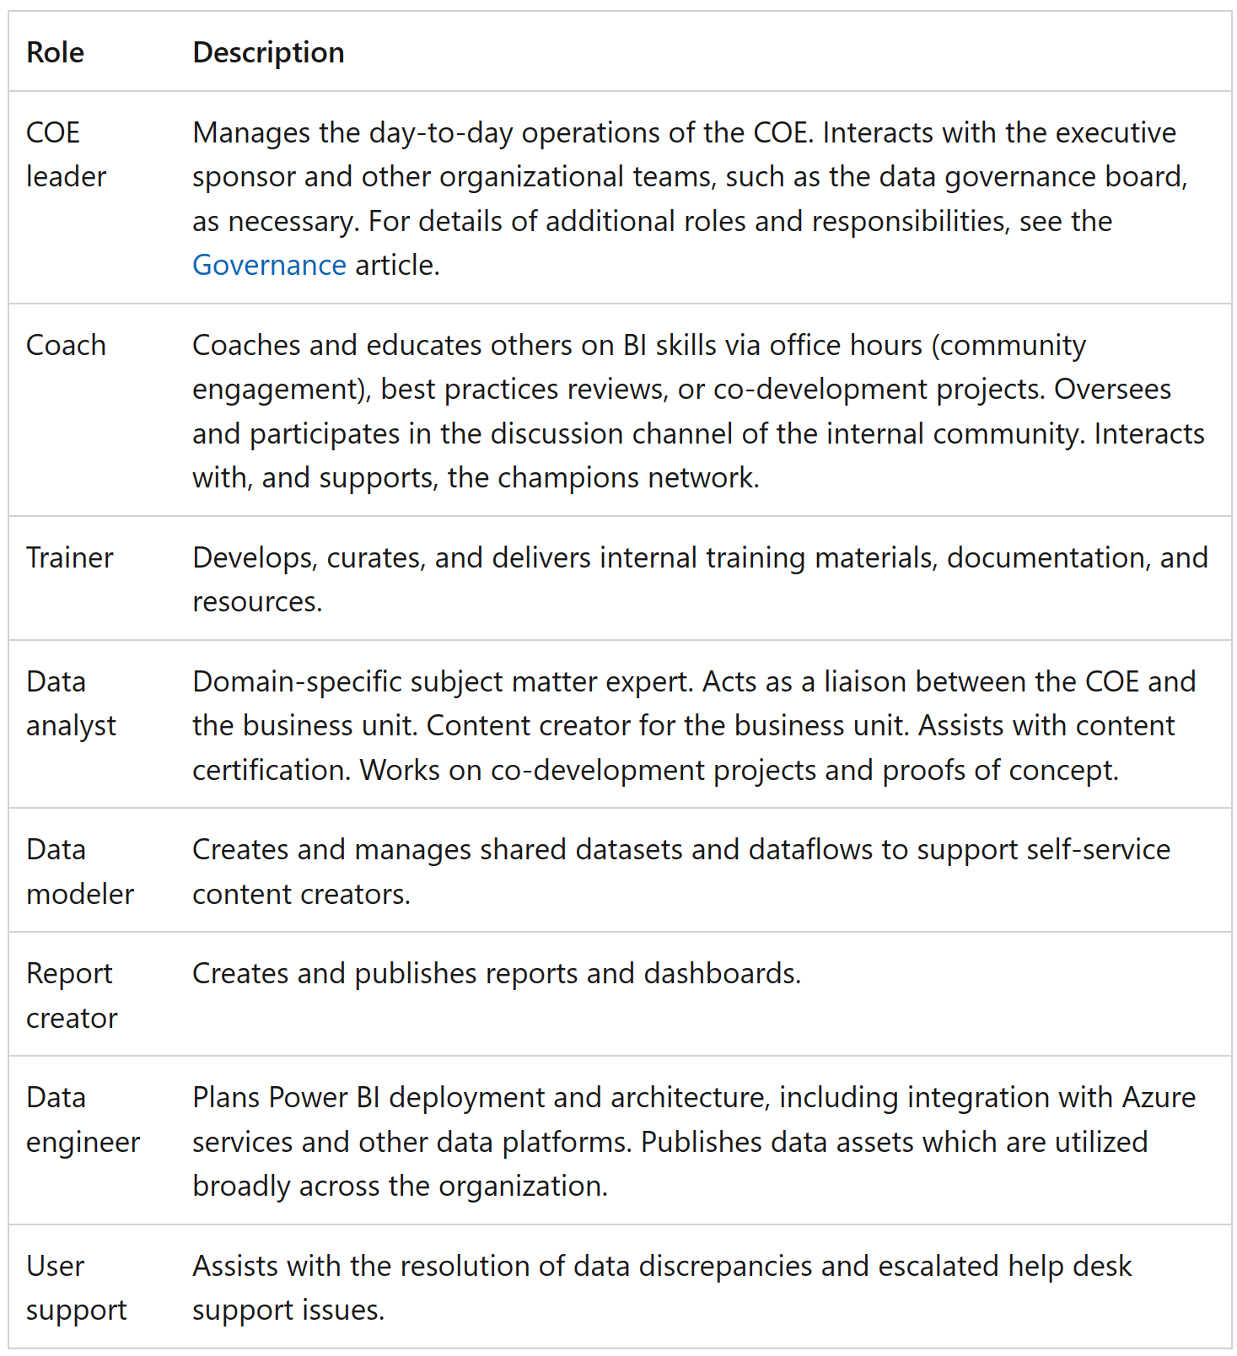
Center of Excellence (COE) Create an Implementation Plan – Staff Team
Define Goals
Scope Responsibilities
Staff Team
Build and Empower the community
Good candidates are those who:
Have a vested interest in seeing Power BI be used and adopted successfully (a career bet)
Understand the analytics vision for the organization.
Have a desire to continually improve analytics practices for the organization.
Have a deep interest in, and expertise with, Power BI.
Take the initiative to continually learn, adapt, and grow.
Readily share their knowledge with others.
Are interested in repeatable processes, standardization, and governance with a focus on user enablement.
Are hyper-focused on collaboration with others.
Are comfortable working in an agile fashion.
Have an inherent interest in being involved and helping others.
Can effectively translate business needs into solutions.
Communicate well with both technical and business colleagues.

Slide 38
Center of Excellence (COE) Create an Implementation Plan – Build and Empower
Define Goals
Scope Responsibilities
Staff Team
Build and Empower the community
Build
If PBI is already broadly deployed, poll existing users to understand the key areas of strength, issues, challenges, and goals; if available, use the monitoring reports to identify key users.
Find the internal champions that can help “shepherd the platform along”.
Enhance the internal community with connections to local user groups, the Microsoft PBI team, and (where applicable) local partners. Define and begin delivery of regular touch points
Empower
Remember the COE needs to be able to serve both new and existing users – at different skill levels.
If an analyst or BI practitioner wanted to start leveraging Power BI, how would they begin?
End-users will not create data models (they may not even create reports) but they will still want to learn how to find reports, how to use bookmarks, set up subscriptions, etc. Is there an onboarding site, is there end-user training available?
With regular touchpoints and community interactions, the COE will be able to see what user are doing, and continue to find opportunities to educate, make things easier and more efficient, and refine the guardrails
Action Item(s)
Start small – pick one area that can deliver a win for the organization/end-user community.
Combine community events/training with actionable follow ups i.e. encourage a hear-see-do approach where possible.

Slide 39
Center of Excellence (COE) Case Study – ABC Company
Background
ABC Company, a large manufacturer in the U.S., had an existing footprint of 1000 active Power BI users, along with two Premium capacities. An engineering group within the organization, in the process of migrating an on-premise Hadoop environment, began ramping up its usage of Power BI.
Consisting of engineers, data analysts, and several hundred end-users, there was concerns around
data duplication
deployment lifecycle management, and
establishment and implementation of best practices.
A director of data engineering, within the group, reached out to Microsoft to talk about his concerns and seek input/guidance for moving forward.
ABC reviewed existing links/resources – and began to put in place as set of informal goals/objectives for a COE.
Team and Scope
Given there was already an existing Power BI community, along with an admin team, the director put focus on supporting the roughly 400 users within the core engineering group
His team was virtual – and initial efforts were designed to address issues related to self-service analytics – specifically, the use of legacy tools, reliance on experts with limited bandwidth, and lack of best-practices related to data acquisition and refresh.
The organization already had logging/monitoring of PBI activities in-place, but the data and associated reports were limited to a small IT team. It was recommended to give the extended team access to the reports.

Slide 40
Center of Excellence (COE) Case Study – ABC Company
Build
Noticing many users were extracting data to their local machine (using a legacy home-grown tool), copying the data (as files) to SharePoint folders, and then building the Power BI Desktop reports (from the files in SharePoint), the group decided to first invest in building out a playbook for self-service analytics. The playbook would -
show users how to leverage Power Query to connect to some of the more popular organizational data sources (including the new cloud data warehouse)
give step-by-step guidance of how to build, publish, and refresh a report
provide links to workspaces with example reports
Empower
To introduce the playbook, it was suggested to first select and work with a small “pilot” group to use the playbook guidance in refactoring an existing report.
The group could then present (at an upcoming internal user-group meeting) their implementation – and talk about how the new approach
saved time,
reduced dependency on automation scripts, and
eliminated potential points of failure.
At the end of the group meeting, the playbook would be the “leave-behind”, (hear-see-do)
In parallel to the playbook, the team also begin building a training course – based on publicly available content but customized to include common ABC data sources, and oriented around how to address specific business problems e.g., analyzing product yield.

Slide 41
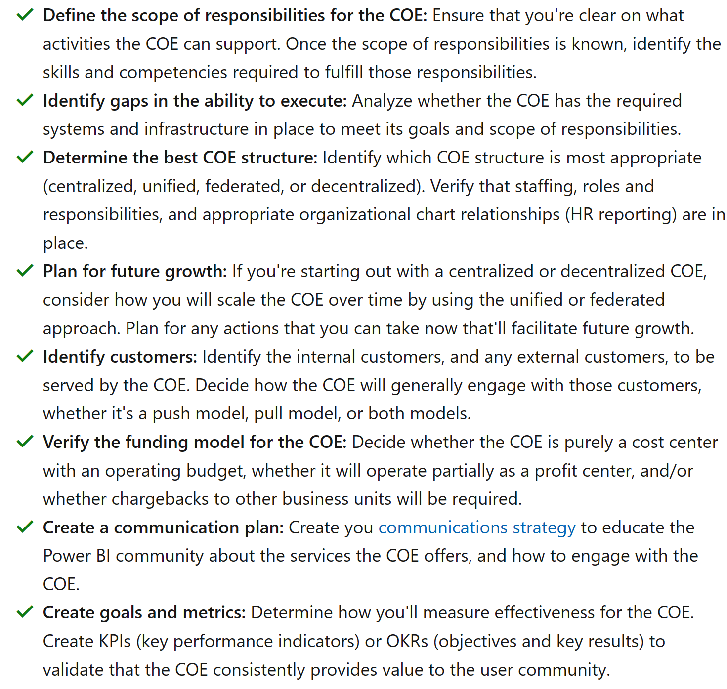
Center of Excellence (COE) Checklist and Resources
Resource/Links
Power BI Center of Excellence (COE) documentation (part of the Adoption Roadmap)
Summary of customer implementations, and a case study of a COE rollout at a manufacturing account
Microsoft’s internal transformation.
How Rockwell Automation is building a world-class Power BI Center of Excellence - YouTube
Building a Power BI Center of Excellence with Alex Garcia - YouTube
Introducing the PowerApps Center of Excellence Starter Kit | Microsoft Power Apps
Customer stories with Fiserv and Schlumberger - BRK1014 - YouTube

Slide 42
Master Data Management (MDM) Overview and Resources
Definition(s)
Defining and Managing the “nouns” of the business e.g., Employee, Vendor, Product, Customer
Comprised of data cleansing, transformation, and integration practices
May be used to synchronize applications (ERP, CRM, HSE, etc.), to manage hierarchies, and/or as a feeder to analytic systems/data warehouses
Note – in the context of analytics, implementation of a formal MDM product usually comes after a level of analytic maturity is achieved
Microsoft and Partner Capabilities
For on-premise deployments, Microsoft provides master data management capabilities as part of SQL Server Master Data Services (MDS)
Many existing customers use a partner, Profisee, as part of their implementation
Profisee also provides value-added capabilities on top of the MDS platform (e.g., data quality)
Microsoft does not currently provide a cloud-first, PAAS MDM offering
Profisee offers master data capabilities in Azure – it is a PAAS offering that runs in a customer’s tenant
We recommend customers consider Profisee for cloud-based MDM

Slide 43
Data Sources Managing & Exposing
Data Steward
Power BI Champion
Self-Service BI may require access to original source systems, data warehouses, big-data stores, and/or 3rd party data sources
The Data Steward, along with source systems owners and data administrators, is responsible for providing access to the system(s) they control
Common concerns and issues WRT data sources & Power BI
This tool makes data proliferation easier (Your giving my users a bigger gun)
For imported data models, Power BI is similar to an Excel spreadsheet; it is a local copy of a data source that has been extracted and potentially transformed/blended with other data sources. However, the Power BI Service helps reduce data proliferation (emailing spreadsheets and copying charts/graphs into PowerPoint deck.
Power BI provides a level of auditing/monitoring that isn’t available with local spreadsheets (covered later) – which makes it possible to “upgrade” popular data models to an IT-Managed/Enterprise approach in the future
The data is stored in the cloud – I have security, safety, compliance concerns
Who has access to this data – how do we secure it
To address concerns, consider a set of PBI Desktop “templates” to
Standardize data access patterns/practices
Encourage direct access to authoritative data
Consider the use of a “Data Catalog” to make it easier for
Data Stewards to publish and describe authoritative data sources
End-Users to find/consume these data sources
https://powerbi.microsoft.com/en-us/documentation/powerbi-desktop-data-sources/

Slide 44
Agenda
Introductions and Expectations for the Day
Architectural Overview of Power BI
Roles/Responsibilities
Provisioning of Services, Users, & Software
Training and Evangelism
Managing/Exposing Data Sources
Publishing and Sharing Content - Best Practices
Supporting Data Refresh and Live Connections
Security Best Practices
Monitoring and Auditing activity

Slide 45
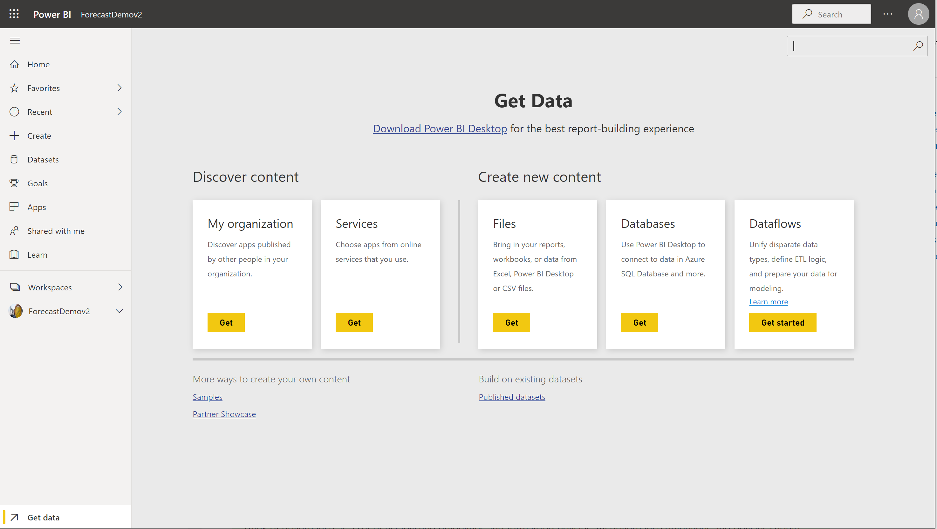
Publishing and Sharing Content Overview
Power BI Champion
Power User
BI Practitioner
How data & reports get into the Power BI Service
Discover Content (“Apps”)
My Organization
Services
Create new content (Power BI Desktop / Excel)
Files - upload .pbix file (alternative to publishing from Desktop)
Databases – don’t use!
Dataflows – (Power Query data prep in the Service)
Build on existing (published) datasets
Where to Publish
My Workspace
App Workspace
What gets Published
Dataset (Imported or Live Connection)
Report
What you can create (after publishing initial content)
Additional Reports / Dashboards
Apps and/or “published” datasets

Slide 46
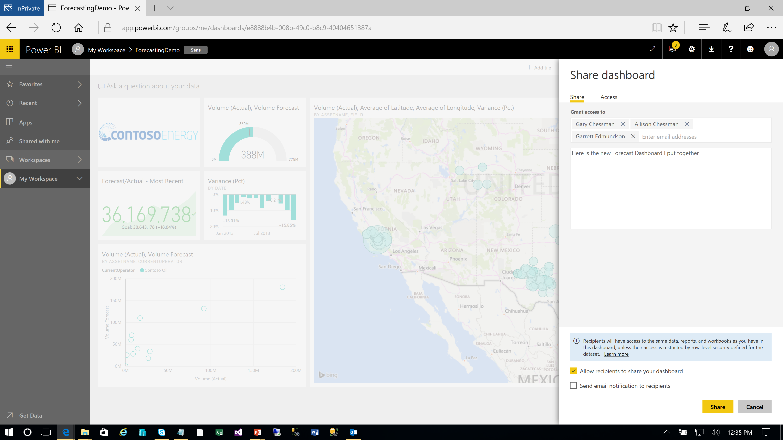
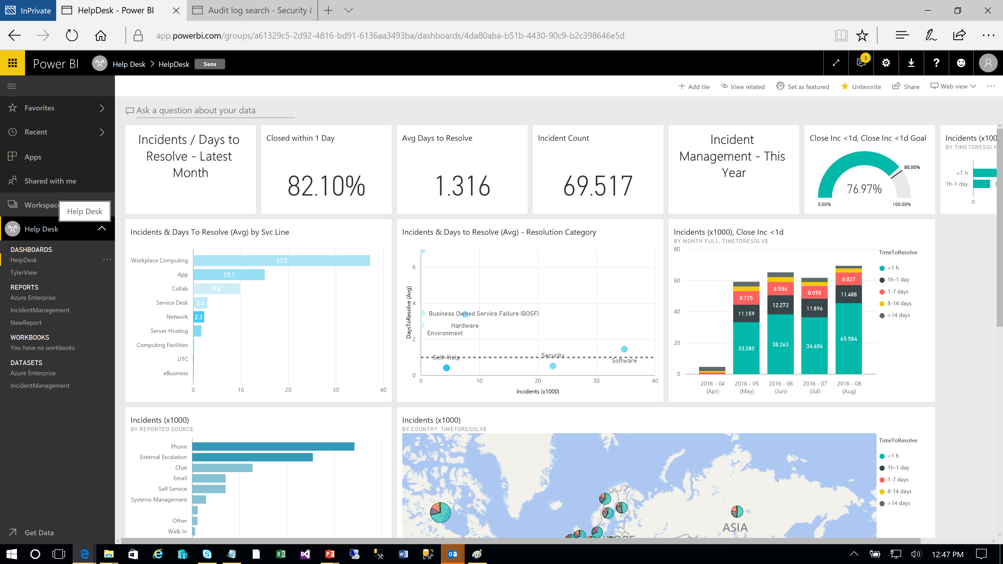
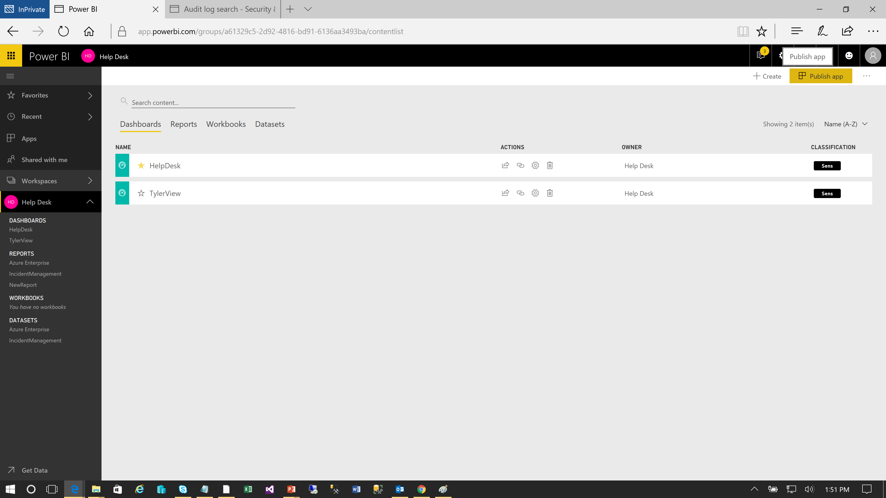
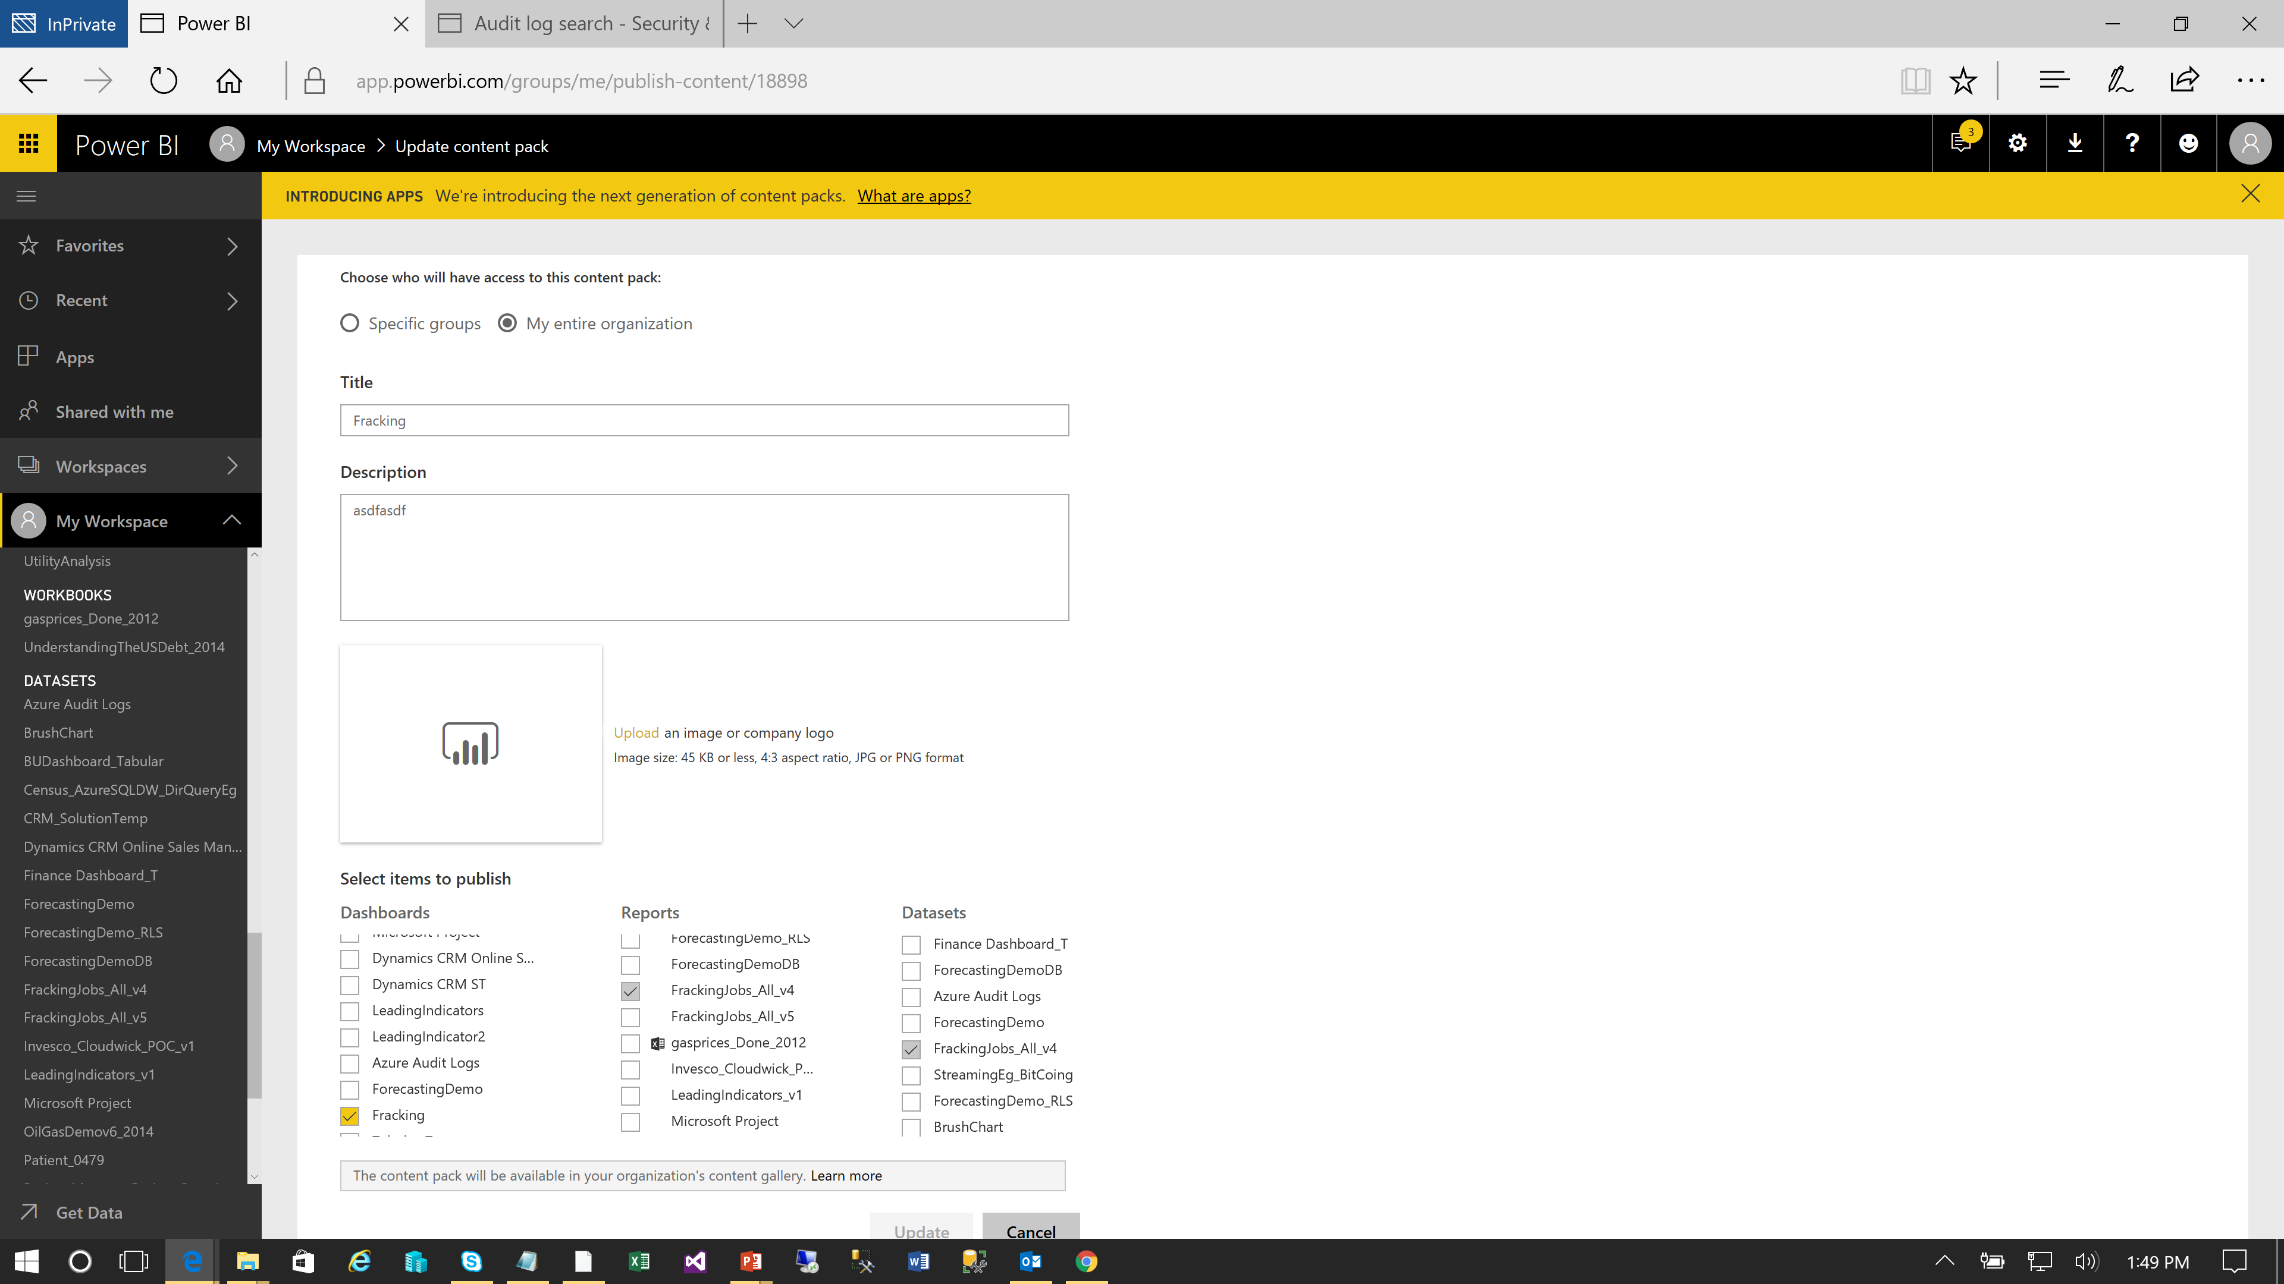
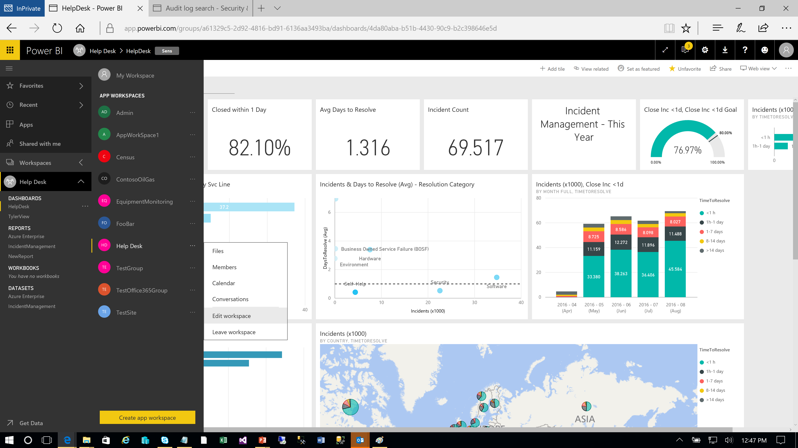
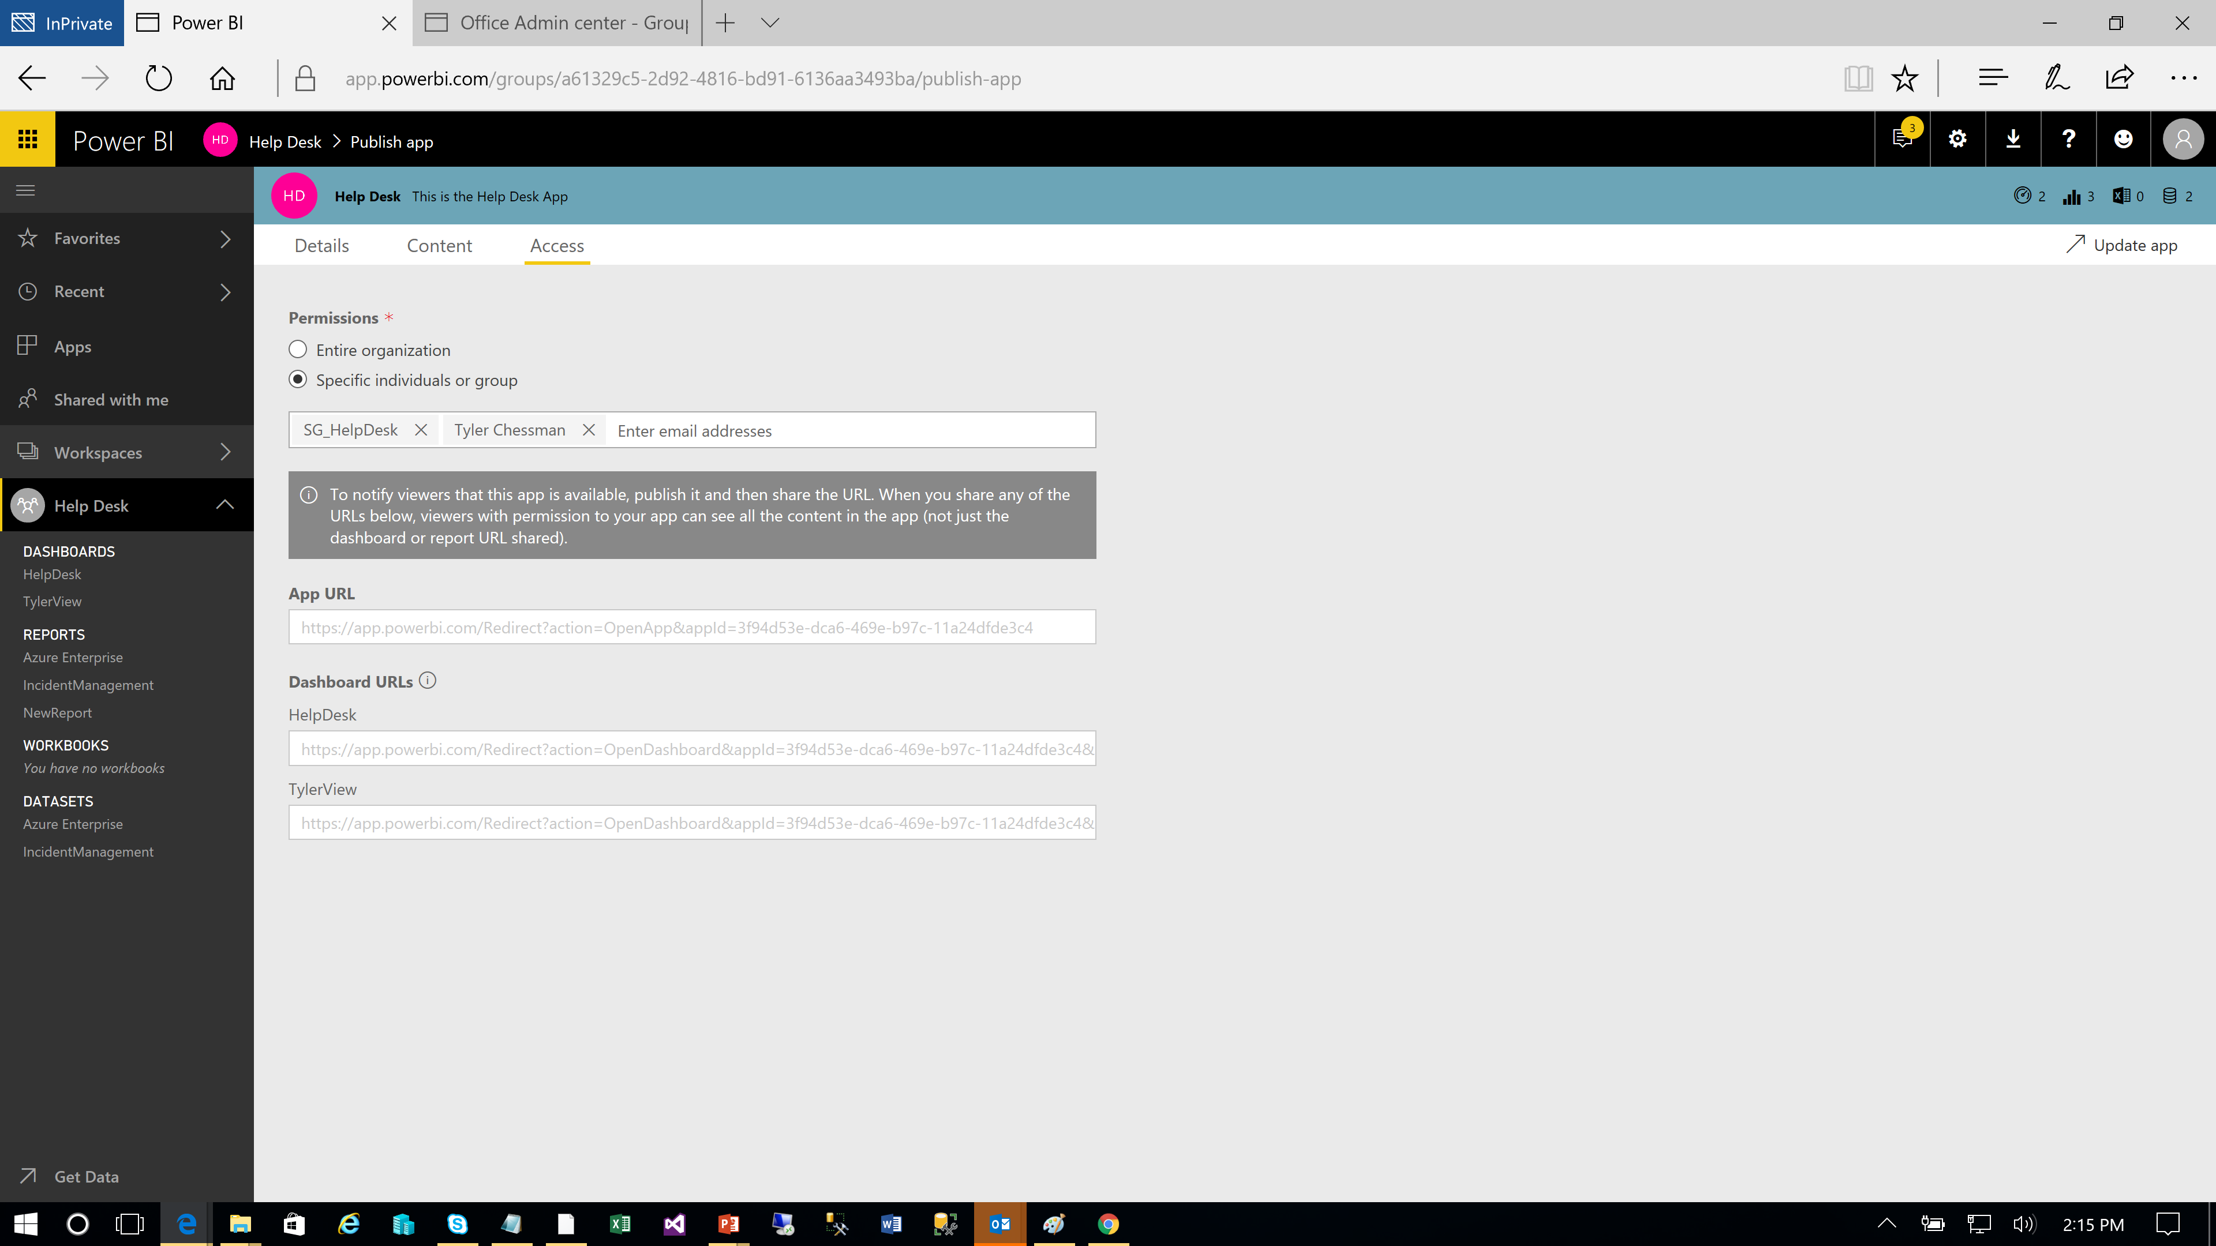
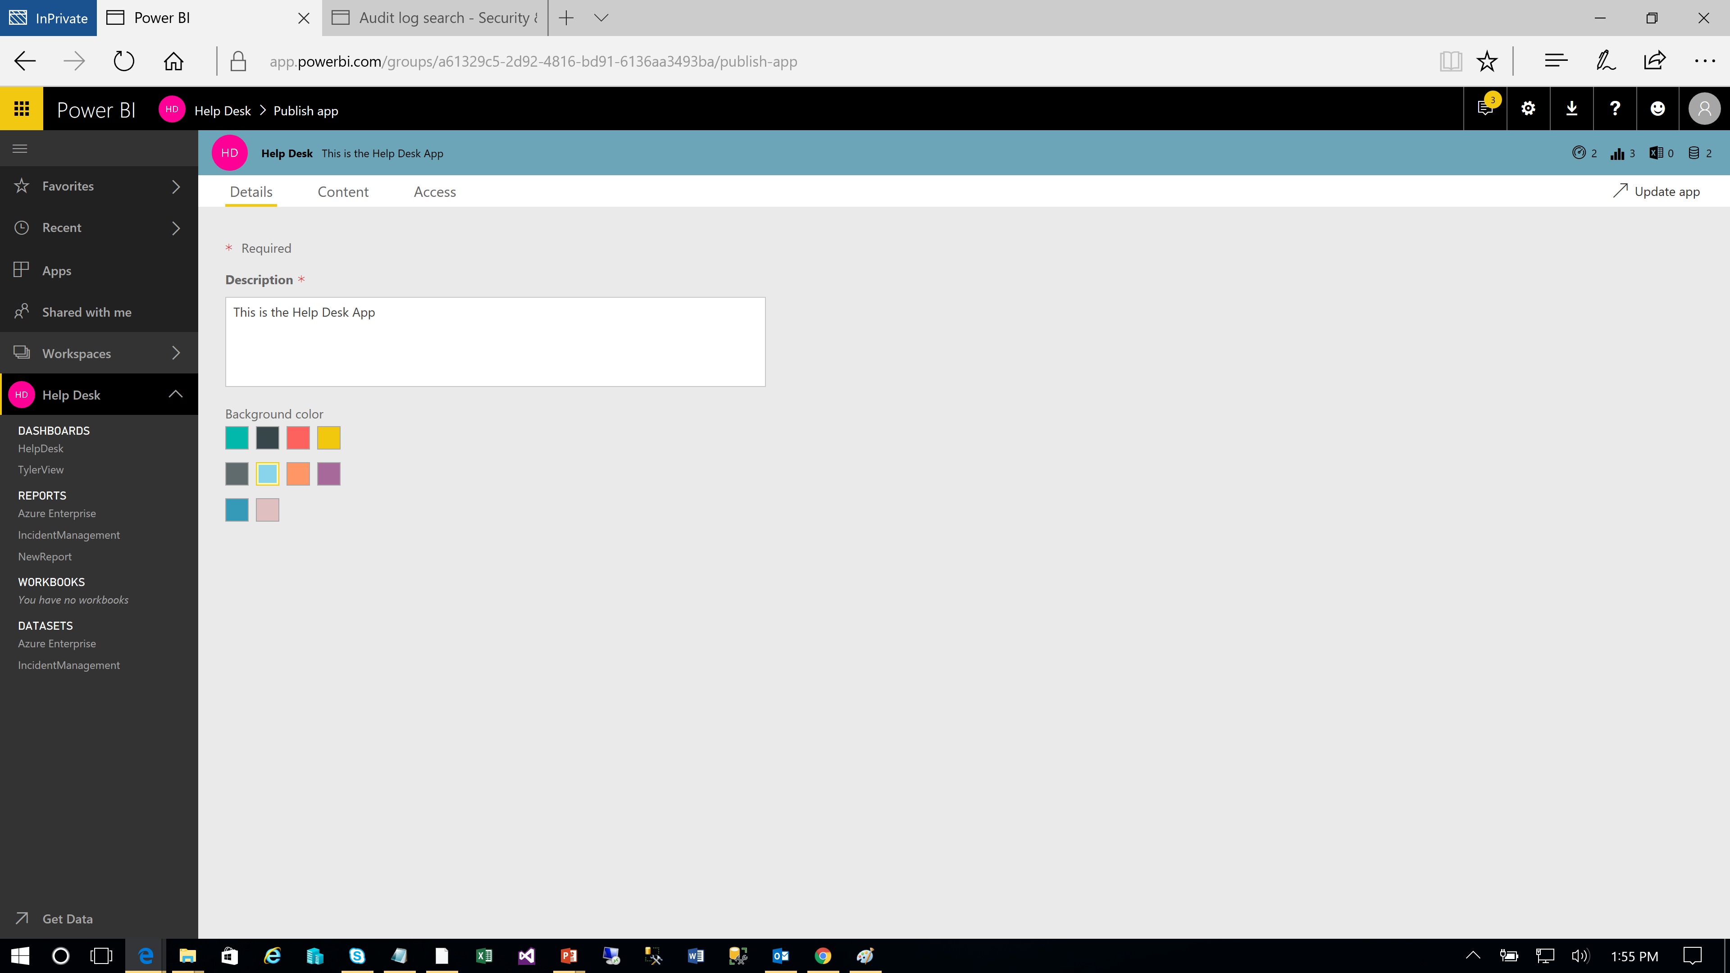
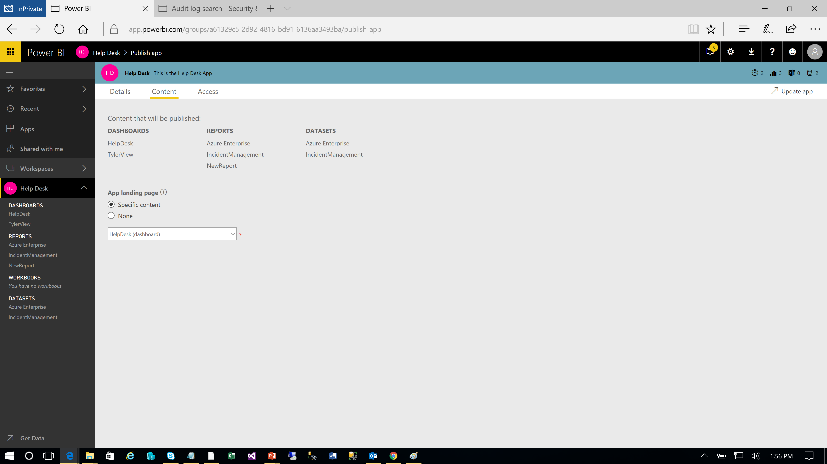
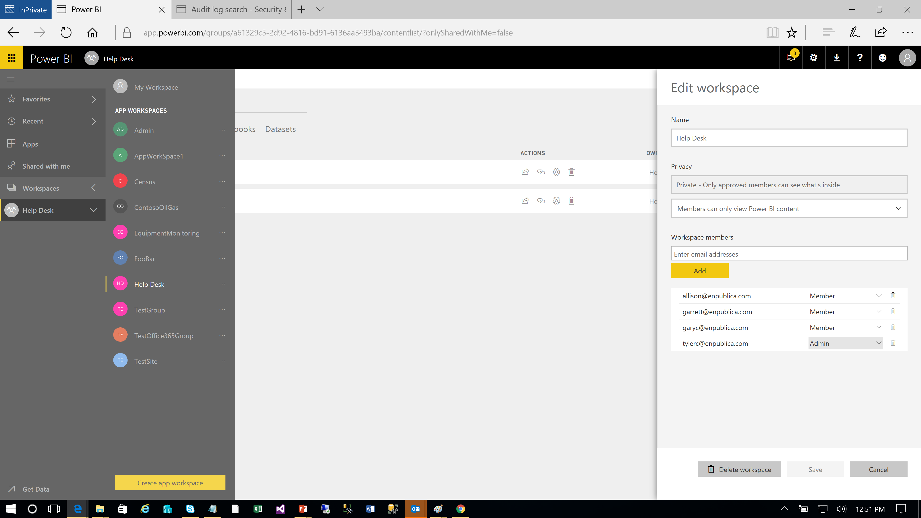

Publishing and Sharing Content Different Sharing Options
Power BI Champion
Power User
BI Practitioner
Share a Dashboard / (Share a Report)
Share via a list of email addresses (new – security groups)
Recommendation – Use Sparingly. Monitor for usage and choose different approach for larger audiences
Use an App Workspace
Add admins and members/contributors/viewer to a workspace; deploy content directly to the workspace – no “publishing” or explicit sharing necessary
Note – members can have read-only or edit rights
Publish an App
You can select what workspace content is included in an App (but currently only 1 App per workspace)
User can customize with report filters or by saving a report copy to their workspace
Share a Dataset
Let users create their own reports in PBI Desktop and other workspaces
Users can extend dataset with additional measures, composite models
*Users can get your apps in a few different ways:
They can find and install your app from Microsoft AppSource
You can send them a direct link.
You can install it automatically in your coworkers' Power BI accounts if your Power BI administrator gives you permission.

Slide 47


Publishing and Sharing Content V2 App Workspaces
Power BI Champion
Power User
BI Practitioner
As of April 2019, the “new workspace” experience is available in Power BI
Assign workspace roles to user groups: security groups, distribution lists, Office 365 groups, and individuals.
Create a workspace in Power BI without creating an Office 365 group.
Use more granular workspaces roles for more flexible permissions management in a workspace.
Plan to use the new workspaces when possible (see existing limitations per the URL below)
New Workspace roles →
What should a workspace contain? A few ideas…**
New Workspace roles*
*Viewer role now available as well (read-only access)
**pg 107, Enterprise Deployment Whitepaper
https://docs.microsoft.com/en-us/power-bi/service-create-the-new-workspaces

Slide 48
Publishing and Sharing Content Use Case Recommendations
Power BI Champion
Power User
BI Practitioner
Use Case | Dashboard/Report Share | Workspace Membership | Shared Dataset | App
Share a “read-only” view with small team | Use Sparingly | Yes (first create an App workspace*) |  | Yes (first create an App workspace)
Share a “read-only” view with a large audience e.g., everyone, a particular security group |  | Perhaps, with Viewer Role |  | Yes
Developer/Project “shared space” |  | Yes - but remember permissions allow overwrite of content
Share a report / data model that can be customized/extended |  | Yes – but with overwrite caveat | Yes | Yes, combine with Shared Dataset
*New App Workspaces generally available as of Apr 2019
** Shared datasets - https://docs.microsoft.com/en-us/business-applications-release-notes/october18/intelligence-platform/power-bi-service/shared-certified-datasets, https://docs.microsoft.com/en-us/power-bi/service-datasets-share
Back

Slide 49
Publishing and Sharing Content Workspaces and Permissions
Power BI Champion
Power User
BI Practitioner
Apps – Instead of Workspace Memberships
Provides an additional abstraction tier between development and end-users (e.g., Report modifications, extra reports in workspace)
Still need to add the user to the app….
Customer Story – Moving from Report to App model
Wanted abstraction tier (above),
Users vs Groups
Allow for managing security/roles outside of (independent of) Power BI
Note – Groups can be [AAD] security group, M365 group, or distribution list
How to retrofit oversight/processes
Publish Best Practices / example Workspace
(As Applicable) – Adjust Tenant settings for Create Workspaces
Monitor (Audit Logs, REST APIs) the assignment of workspace permissions – e.g., viewer role
Monitor (e.g., REST APIs) the users of a group
https://docs.microsoft.com/en-us/power-bi/service-create-the-new-workspaces
Notes:
Power BI Workspace permissions. How can a BI COE retain oversight and at the same time not be tightly coupled into day to day processes such as adding/removing users.

Slide 50
Agenda
Introductions and Expectations for the Day
Architectural Overview of Power BI
Roles/Responsibilities
Provisioning of Services, Users, & Software
Training and Evangelism
Managing/Exposing Data Sources
Publishing and Sharing Content - Best Practices
Supporting Data Refresh and Live Connections
Security Best Practices
Monitoring and Auditing activity

Slide 51
Data Refresh & Live/DQ Connections Overview
Power User
Power BI Admin
Data Steward
Recall – Power BI Desktop supports three operating modes (along with composite mode)
Import. Data is pulled down, compressed, and saved as part of the Power BI Desktop file (.pbix).
Note – Excel PowerPivot workbooks and Service Packs are also imported models
Create a Live Connection (DirectQuery / Connect Live) . A live connection to 1 data source (composite mode allows for multiple)
After the .pbix file is published into the Power BI Service….
Basic workflow for supporting Data refresh and Live Connections
Power BI Administrator installs an on-premise data gateway on a server/virtual machine within the corporate datacenter; he “registers” the gateway with the Power BI Service using a Power BI Pro account
Note - multiple gateways can be installed; each gateway can support 1-to-many back-end data sources
The Power BI Administrator (from the Power BI console) adds 1 or more data sources to the gateway; he adds users/groups who will be allowed to use this gateway for refresh or live connections
The Power User publishes .pbix file to the Power BI Service; he specifies (for the dataset) a gateway to use for refresh/live connections
Mode | View in the Service | Schedule Refresh in the Service
Import | No further configuration needed | Personal or On-Premise Data Gateway may be required
Live Connection | On-Premise Data Gateway may be required | N/A

Slide 52
Data Sources Gateway / Use for cloud data sources (Azure SQL), when, and why
By default, the Gateway is not required to connect to cloud data sources, like SQL Azure
Azure SQL DB allows Firewall rules to restrict client IP access
The “allow access to Azure Services” option (On/Off) allows access from Azure Resources, including VMs
To further restrict Azure SQL DB access, Vnet service endpoints can be employed
Architecture discussion to include clustering, high availability, disaster recovery and operational excellence
By deselecting “allow access to Azure Services”, the Power BI Service can no longer connect to the database
The workaround is to use the on-premise data gateway on a VM residing within the Subnet
Note the restrictions on this approach
Must use the SQL Connector, and only basic authentication is supported
UPDATE – 2021 – Power BI Now Supports Virtual Network data gateways
Only available in Power BI Premium workspaces
Allows import or direct query datasets to connect to data services within an Azure VNet without the need of an on-premises data gateway.
https://azure.microsoft.com/en-us/blog/securing-the-connection-between-power-bi-and-azure-sql-database/
Notes:
Gateway and Cloud Source like Azure SQL DB –
https://azure.microsoft.com/en-us/blog/securing-the-connection-between-power-bi-and-azure-sql-database/
https://ideas.powerbi.com/forums/265200-power-bi-ideas/suggestions/37702114-powerbi-gateway-add-azure-sql-database-as-a-data

Slide 53


The Virtual Network (VNet) Data Gateway Overview
Supported Azure data services (as of Oct. 2022) for Power BI -
Use virtual network (VNet) data gateway and data sources in Power BI | Microsoft Learn
Helps you “connect from Microsoft Cloud services [PBI] to your Azure data services within a VNet without the need of an on-premises data gateway.” Currently available for Premium/PPU workspaces.
Creation Steps:
Register Microsoft.PowerPlatform as a resource Provider (in the subscription where the data service resides)
Associate the subnet to the Microsoft Power Platform
Assumes you have already created a VNet – and associated the data service(s) to the VNet
This subnet cannot be shared with other services
Create the VNet data gateway
This is done in the Power Platform admin center
https://learn.microsoft.com/en-us/data-integration/vnet/overview

Slide 54

The On-Premises Data Gateway Overview
The on-premises data gateway acts as a bridge, providing quick and secure data transfer between on-premises data (data that is not in the cloud) and the Power BI, Microsoft Flow, Logic Apps, and PowerApps services.
Two different gateway modes
On-premises data gateway: multiple users can share and reuse a gateway; can be used by Power BI, PowerApps, Flow or Logic Apps. For Power BI, this includes support for schedule refresh & DirectQuery
Personal: for Power BI only and can be used as an individual without any administrator configuration*. This can only be used for on-demand refresh and schedule refresh.
*The on-premise gateway installs as a service. Personal gateway will install as a service or, without admin rights, an application
https://powerbi.microsoft.com/en-us/documentation/powerbi-gateway-onprem/

Slide 55

Keeping data current in Power BI
On-Premises Data Gateway
IT can install the On-Premises Data Gateway to serve large groups of users to refresh supported on-premises data sources
IT can:
Centrally manage the set of users who have access to the underlying data sources
Gain visibility into gateway usage, such as most commonly accessed data sources, and the users accessing them
Ports. The gateway creates an outbound connection to Azure Service Bus. It communicates on outbound ports: TCP 443 (default), 5671, 5672, 9350 thru 9354. The gateway does not require inbound ports.
Power BI data sources - Power BI | Microsoft Docs
Notes:
Power BI Knowledgebase: https://powerbi.microsoft.com/en-us/documentation/powerbi-gateway-enterprise/

Slide 56
How the Gateway works
.
What happens when a user interacts with an element connected to an on-premises data source -
A query will be created by the cloud service, along with the encrypted credentials for the on-premises data source, and sent to the queue for the gateway to process.
The gateway cloud service will analyze the query and will push the request to the Azure Service Bus.
The on-premises data gateway polls the Azure Service Bus for pending requests.
The gateway gets the query, decrypts the credentials and connects to the data source(s) with those credentials.
The gateway sends the query to the data source for execution.
The results are sent from the data source, back to the gateway, and then onto the cloud service. The service then uses the results.
https://powerbi.microsoft.com/en-us/documentation/powerbi-gateway-onprem-indepth/
Notes:
Power BI Knowledgebase: https://powerbi.microsoft.com/en-us/documentation/powerbi-gateway-enterprise/

Slide 57

The On-Premises Data Gateway SSO
SSO is currently supported (for DirectQuery*) for the following data sources –
SQL Server (Kerberos)
SAP HANA (Kerberos and SAML)
SAP BW (Kerberos)
Teradata (Kerberos)
Spark (Kerberos)
Impala (Kerberos)
Query Steps when running SSO
For each query, the Power BI service includes the user principal name (UPN) when sending a query request to the configured gateway.
The gateway needs to map the Azure Active Directory UPN to a local Active Directory identity.
If Azure AD DirSync (also known as Azure AD Connect) is configured, then the mapping works automatically in the gateway.
Otherwise, the gateway can look up and map the Azure AD UPN to a local user by performing a lookup against the local Active Directory domain.
The gateway service process impersonates the mapped local user, opens the connection to the underlying database, and sends the query.
* Live Connections to SSAS use impersonation via EffectiveUserName
https://docs.microsoft.com/en-us/power-bi/service-gateway-sso-overview

Slide 58

Gateway Management/Monitoring
Management
Today, anyone with a Pro license can install a gateway.
Consider organization policies to monitor/prevent unwanted installations
Audit logs can also monitor gateway events
Consider a “shared” Power BI Pro Account (e.g., “GatewayAdmin”) to configure/register a Gateway (the gateway is tied to a single Pro Account – though multiple admins can be added to the gateway)
New – Power Platform Admin Center to see full list of gateways installed.
Monitoring
The Gateway can be monitored via Service availability/Performance Counters
The following link details an approach and considerations in monitoring the On-Premises Data Gateway - https://insightsquest.com/2016/08/08/monitor-on-premises-data-gateways/
New - https://docs.microsoft.com/en-us/power-bi/service-gateway-performance-monitoring
New – https://github.com/RuiRomano/pbigtwmonitor
High Availability
(Dec 2017) - High availability with active/passive configuration now available (load-balancing is now available as well) - https://docs.microsoft.com/en-us/power-bi/service-gateway-high-availability-clusters
(Older) Alternative, use a recovery key for a smooth take-over scenario
Install a gateway on the first machine, configure, and note the recovery key
Install a gateway on a 2nd machine – but don’t configure
Choose “Migrate, restore, or takeover an existing gateway” option
Notes:
Power BI Knowledgebase: https://powerbi.microsoft.com/en-us/documentation/powerbi-gateway-enterprise/

Slide 59
DEMO On Premise Data Gateway

Slide 60
Lifecycle Management Moving from Dev to Test to Production
Power BI Champion
Power User
BI Practitioner
Assumption – You are using an App for “deployment to the masses”
App is deployed within a workspace with a small set of Admins/Members; Admins are responsible for member management and app publishing.
Members are the developers and/or power users who participate in creating/maintaining/validating content
Option 1 – One Workspace
Use the “Included in App” capability to include/exclude items from App (dashboards/reports)
Changes to “included” dashboards/reports are not visible to the App until the App is updated (re-published)
Note that “breaking changes” – e.g., removing/renaming a dataset table field, are reflected immediately (i.e. no dataset versioning)
Option 2 – Multiple Workspaces
Note that you can still use the “Included in App” capability to include/exclude items from App (dashboards/reports)
But now, initial creation of content and changes to existing content (including datasets, reports, and dashboards) is done in a workspace that is independent of the “Production” workspace
Migration of content from workspaces can be done manually or via scripts (Power BI Rest APIs) e.g., https://powerbi.microsoft.com/en-us/blog/duplicate-workspaces-using-the-power-bi-rest-apis-a-step-by-step-tutorial/
Datasets can also be updated to point to a different data source via script
Option 3 – Deployment Pipelines
https://docs.microsoft.com/en-us/power-bi/create-reports/deployment-pipelines-overview
https://docs.microsoft.com/en-us/rest/api/power-bi/

Slide 61
Lifecycle Management Deployment Pipelines
Power BI Champion
Power User
BI Practitioner
Enables BI creators to manage content lifecycle
Available with Premium Capacity.
Includes reports, paginated reports, dashboards, and datasets (dataflows not included as of Apr 2021)
Designed as a pipeline with 3 stages
Development
Test
Production
https://docs.microsoft.com/en-us/power-bi/create-reports/deployment-pipelines-overview

